Slide 1
BLM2031 YAPISAL PROGRAMLAMA – EKİM 2022
Sunan: Dr. Ahmet ELBİR
GENEL BİLGİLER
DERS GRUPLARI
Gr.1 Dr. Öğretim Üyesi Yunus Emre SELÇUK (YES)
Gr.2 Dr. Ahmet ELBİR (AEL) (Biz)
İLETİŞİM
İletişim bilgileri
Oda : D-124
e-mail: aelbir@yildiz.edu.tr
İletişim için öncelikle e-mail gönderiniz, yüz yüze görüşme için randevu isteyiniz.
DERS NOTLARI ve KAYNAKLAR
https://avesis.yildiz.edu.tr/yselcuk/dokumanlar
Önceki katkıları için Z. Cihan Tayşi, H. İrem Türkmen, Zeyneb Kurt hocalarımıza teşekkür ederim.
Darnell P. A. and Margolis P. E., C: A Software Engineering Approach, 3rd ed., Springer-Verlag, 1996 (notların oluşturulduğu asıl kaynaktır).

Slide 2
BLM2031 YAPISAL PROGRAMLAMA – GENEL BİLGİLER
BAŞARIM DEĞERLENDİRME
Uygulama ve lab. çalışmaları:
17/10/2022 itibariyle başlar, dönüşümlü yapılır.
Dersi alan tüm öğrenciler lab. çalışmalarına katılmak zorundadır.
Ara sınav: 22/11/2022 (8.hafta)
Proje ödevi: Ayrıntılar ileride duyurulacak
Ara sınav mazereti: 03/01/2023 (14.hafta) (yönetmelik kuralları uyarınca)
Final sınavı: Final haftasında
Bölümün sayfasında duyuracağı vize ve final programlarına göre, haftalar ve hatta günler ile saatler değişebilir.
Puanlama (değişebilir):
1. Ara sınav %25, Lab. %15, Proje %20, Final %40
Yapıl(a)mayan değerlendirmenin not ağırlığı yapılanlara paylaştırılır.

Slide 3
BLM2031 YAPISAL PROGRAMLAMA – GENEL BİLGİLER
DERS İÇERİĞİ
Hatırlatma: C’de veri tipleri, Bitsel işlemler, Kontrol deyimleri, Döngüler, Diziler
İşaretçiler: İşaretçiler Aritmetiği, diziler ve işaretçiler, İşaretçi Dizileri, Karakter Dizileri, İşaretçilerin İşaretçisi
Dinamik Bellek Yönetimi ve Fonksiyonlar, Fonksiyon İşaretçileri, Özyineleme
Yerel ve Global Değişkenler, Depolayıcı Sınıflar, Yapılar, Birlikler
Dosya işlemleri
C Önişlemcileri ve Makrolar
Statik ve Dinamik Kütüphaneler

Slide 4
BLM2031 YAPISAL PROGRAMLAMA – GENEL BİLGİLER
ÖNEMLİ SENATO KARARLARI
Öğrencinin ara sınav notunun %60'ı + Finalin %40'ı eğer "sayısal olarak" 40'ın altında kalıyorsa öğrenci doğrudan "FF notu" ile dersten kalmış sayılacaktır (YN-027-YTÜ Önlisans ve Lisans Eğitim-Öğretim Yönetmeliği, Md. 26.e).
Yarıyıl sonu sınavına girmeyen öğrenciler vize notuna bakılmaksızın ilgili dersten başarısız (FF) sayılırlar (YÖ-075-YTÜ Sınav Yönergesi, Md. 4.2.k).
Bütün öğrencilere derslere devam zorunluluğu gelmiştir (dersi tekrar alanların önceki notu ne olursa olsun).
Derslere ait devam durumu ilgili öğretim üyesi tarafından yarıyıl sonu sınavları başlamadan önce öğrenci bilgi sisteminde ilan edilir.
Devamsızlıktan kalan öğrenciler yarıyıl sonu sınavına giremezler ve bu öğrencilerin ilgili derse ait başarı notu (F0) olarak bilgi sistemine işlenir (YÖ-075-YTÜ Sınav Yönergesi, Md. 4.2.h).

Slide 5
A Fast Review of C Essentials Part I
Structural Programming
by Z. Cihan TAYSI
additions by Yunus Emre SELÇUK

Slide 6
Outline
Program development
C Essentials
Variables & constants
Names
Functions
Formatting
Comments
Preprocessor
Data types
Mixing types

Slide 7
Program Development
The task of compiler is to translate source code into machine code
The compiler’s input is source code and its output is object code.
The linker combines separate object files into a single file
The linker also links in the functions from the runtime library, if necessary.
Linking usually handled automatically.
source file
source file
source file
compile
compile
compile
object
file
object
file
object
file
Runtime Library
linker
Executable Code

Slide 8
Program Development CONT’D
One of the reasons C is such a small language is that it defers many operations to a large runtime library.
The runtime library is a collection of object files
Each file contains the machine instructions for a function that performs one of a wide variety of services
The functions are divided into groups, such as I/O, memory management, mathematical operations, and string manipulation.
For each group there is a source file, called a header file, that contains information you need to use these functions
by convention , the names for header files end with .h extention
For example, one of the I/O runtime routines, called printf(), enables you to display data on your terminal. To use this function you must enter the following line in your source file
#include <stdio.h>

Slide 9
Variables & Constants
The statement
j = 5 + 10;
A constant is a value that never changes
A variable achieves its variableness by representing a location, or address, in computer memory.
Variable
Address
Contents
4 bytes
2482
j
2486
15
2490

Slide 10
Names
In the C language, you can name just about anything
variables, constants, functions, and even location in a program.
Names may contain
letters, numbers, and the underscore character ( _ )
but must start with a letter or underscore...
The C language is case sensitive which means that it differentiates between lowercase and uppercase letters
VaR, var, VAR
A name can NOT be the same as one of the reserved keywords.

Slide 11
Names cont’d
LEGAL NAMES
j
j5
__sesquipedalial_name_system_name
UpPeR_aNd_LoWeR_cAsE_nAmE
ILLEGAL NAMES
5j
$name
int
bad%#*@name

Slide 12
Names cont’d
reserved keywords = illegal names cont.’d:
auto | double | int | struct
break | else | long | switch
case | enum | register | typedef
char | extern | return | union
const | float | short | unsigned
continue | for | signed | void^{*1}
default | goto | sizeof | volatile
do | if | static | while

Slide 13
Expressions
An expression is any combination of operators, numbers, and names that donates the computation of a value.
Examples
5 A constant
j A variable
5 + j A constant plus a variable
f() A function call
f()/4 A function call, whose result is divided by a constant

Slide 14
Assignment Statements
lvalue
=
rvalue
;
The left hand side of an assignment statement, called an lvalue, must evaluate to a memory address that can hold a value.
The expression on the right-hand side of the assignment operator is sometimes called an rvalue.
answer = num * num;
num * num = answer;

Slide 15
Comments
A comment is text that you include in a source file to explain what the code is doing!
Comments are for human readers – compiler ignores them!
The C language allows you to enter comments between the symbols /* and */
Nested comments are NOT supported
What to comment ?
Function header
changes in the code
/* square()
* Author : P. Margolis
* Initial coding : 3/87
* Params : an integer
* Returns : square of its parameter
*/

Slide 16
Functions
function type
function name
(
arguments
)
{
A C function is a collection of C language operations.
performs an operation that is more complex than any of the operations built into C language
at the same time, a function should not be so complex that it is difficult to understand
Arguments represent data that are passed from calling function to function being called.
declarations
C statements
}

Slide 17
Functions
You can write your own functions and you should do so!
Grouping statements that execute a sub-task under a function leads to modular software
You can reuse functions in different programs
Functions avoid duplicate code that needs to be corrected in multiple places of the entire program if a bug removal or change request emerges.
Bugs and requirement changes are inevitable in software development!

Slide 18
Functions
You should declare a function before it can be used …
int combination( int, int ); //This is also called allusion
void aTaskThatNeedsCombination( ) {
//some code
c = combination(a, b);
//more code
}
int combination( int a, int b ) {
//necessary code
}

Slide 19
Functions
… or the required function should be completely coded before it is called from another function.
int combination( int a, int b ) {
//necessary code
}
void aTaskThatNeedsCombination( ) {
//some code
c = combination(a, b);
//more code
}

Slide 20
Formatting Source Code
int square (int num) {
int answer;
answer = num * num;
return answer;
}
int square (int num) {
int answer;
answer = num * num;
return answer;
}
int square (int num) {
int
answer;
answer = num
* num;
return answer;
}
int square ( int num )
{
int answer;
answer = num * num;
return answer;
}

Slide 21
The main() Function
All C programs must contain a function called main(), which is always the first function executed in a C program.
It can take two arguments but we need to learn much more before going into details.
When main() returns, the program is done.
The exit() function is a runtime library routine that causes a program to end, returning control to operating system.
If the argument to exit() is zero, it means that the program is ending normally without errors.
Non-zero arguments indicate abnormal termination of the program.
Calling exit() from main() is exactly the same as executing return statement.
int main ( ) {
extern int square();
int solution;
solution = square(5);
exit(0);
}

Slide 22
printf() and scanf() Functions
int num;
scanf(“%d”, &num);
printf(“num : %d\n”, num);
The printf() function can take any number of arguments.
The first argument called the format string. It is enclosed in double quotes and may contain text and format specifiers
The scanf() function is the mirror image of printf(). Instead of printing data on the terminal, it reads data entered from keyboard.
The first argument is a format string.
The major difference between scanf() and printf() is that the data item arguments must be lvalues
Scanf requires a memory address as 2nd parameter, hence comes the &

Slide 23
Preprocessor
The preprocessor executes automatically, when you compile your program
All preprocessor directives begin with pound sign (#), which must be the first non-space character on the line.
unlike C statements a preprocessor directive ends with a newline, NOT a semicolon
It is also capable of
macro processing
conditional compilation
debugging with built-in macros

Slide 24
Preprocessor cont’d
The define facility
it is possible to associate a name with a constant
#define NOTHING 0
It is a common practice to all uppercase letters for constants
naming constants has two important benefits
it enable you to give a descriptive name to a nondescript number
it makes a program easier to change
be careful NOT to use them as variables
NOTHING = j + 5

Slide 25
Preprocessor cont’d
The include facility
#include directive causes the compiler to read source text from another file as well as the file it is currently compiling
the #include command has two forms
#include <filename>
the preprocessor looks in a special place designated by the operating system. This is where all system include files are kept.
#include “filename”
the preprocessor looks in the directory containing the source file. If it can not find the file, it searches for the file as if it had been enclosed in angle brackets!!!

Slide 26
hello world!!!
#include <stdio.h>
int main ( void ) {
printf(“Hello World...\n”);
return 0;
}
include standard input output library
start point of your program
return a value to calling program
in this case 0 to show success?
Hint: getch

Slide 27
Data Types
Data types
void
Scalar types
Arithmetic types
Aggregate types
Integral types
Floating types
Pointers
enum

Slide 28
Data Types cont’d
There are 9 reserved words for scalar data types
Basic types
char, int, float, double, enum
Qualifiers
long, short, signed, unsigned
To declare j as an integer
int j;
You can declare variables that have the same type in a single declaration
int j,k;
All declarations in a block must appear before any executable statements
char | double | short | signed
int | enum | long | unsigned
float

Slide 29
Different Types of Integers
The only requirement that the ANSI Standard makes is that a byte must be at least 8 bits long, and that ints must be at least 16 bits long and must represent the “natural” size for computer.
natural: the number of bits that the CPU usually handles in a single instruction
Type | Size (in bytes) | Value Range | Format String
int | 4 | -2³¹ to 2³¹–1 | %d
unsigned int | 4 | 0 to 2³²–1 | %u
short int | 2 | -2¹⁵ to 2¹⁵–1 | %hi
long int | 4 | -2³¹ to 2³¹–1 | %li
unsigned short int | 2 | 0 to 2¹⁶–1 | %hu
unsigned long int | 4 | 0 to 2³²–1 | %lu
signed char | 1 | -2⁷ to 2⁷–1 | %c
unsigned char (rather meaningless) | 1 | 0 to 2⁸–1 | %uc

Slide 30
Format Strings for Integers
A format string determines the representation of a value in output (printf) and the interpretation of a value in input (scanf).
Try the following code with different values:
#include <stdio.h>
int main(int argc, char *argv[]){
int sayi = 65;
printf(" int \t%d\n",sayi);
printf(" uns.int \t%u\n",sayi);
printf(" srt.int \t%hi\n",sayi);
printf(" lng.int \t%li\n",sayi);
printf("usrt.int \t%hu\n",sayi);
printf("ulng.int \t%lu\n",sayi);
printf(" char\t%c\n",sayi);
printf(" uns.char\t%uc\n",sayi);
system("PAUSE");
return 0;
}

Slide 31
Different Types of Integers cont’d
Integer constants
decimal (%d), octal (%o), Hexadecimal (%x)
Decimal | Octal (leading 0 zero) | Hexadecimal (leading 0x zeroX, case insensitive)
3 | 003 | 0x3
8 | 010 | 0x8
15 | 017 | 0xF
16 | 020 | 0x10
21 | 025 | 0x15
-87 | -0127 | -0x57
255 | 0377 | 0xFF
In general, an integer constant has type int, if its value can fit in an int. Otherwise it has type long int.
Suffixes
u or U (for unsigned)
l or L (for long)

Slide 32
Floating Point Types
to declare a variable capable of holding floating-point values
float (%f)
Double (%lf)
The word double stands for double-precision
it is capable of representing about twice as much precision as a float
A float generally requires 4 bytes, and a double generally requires 8 bytes
read more about limits in <limits.h>
Decimal point
0.356
5.0
0.000001
.7
7.
Scientific notation (%e)
3e2
5E-5
Long double can be defined but they can become plain double in some computer platforms
Refer to the source book and the Internet for different representation format modifiers (such as %5.7f)

Slide 33
Format Strings for Real Numbers
#include <stdio.h>
int main(int argc, char *argv[]){
float ondalikli = 700.555;
printf(" dbl \t%f\n",ondalikli);
printf(" dbl \t%.3f\n",ondalikli);
printf(" lng.dbl \t%lf\n",ondalikli);
printf(" exp \t%e\n",ondalikli);
system("PAUSE");
return 0;
}

Slide 34
Initialization
A declaration allocates memory for a variable, but it does not necessarily store an initial value at the location
If you read the value of such a variable before making an explicit assignment, the results are unpredictable
To initialize a variable, just include an assignment expression after the variable name
char ch = ‘A’ ;
It is same as
char ch;
ch = ‘A’;

Slide 35
Mixing Types
Implicit convertion
Mixing signed and unsigned types
Mixing integers with floating point types
Explicit conversion

Slide 36
Mixing Types cont’d
long double
double
float
unsigned long int
long int
unsigned
int

Slide 37
Implicit Conversions
When the compiler encounters an expression, it divides it into subexpressions, where each expression consists of one operator and one or more objects, called operands, that are bound to the operator.
Ex : 1 + 2.5 # involves two types, an int and a double
Ex : – 3 / 4 + 2.5 # The expression contains three operators –, /, +
Each operator has its own rules for operand type agreement, but most binary operators require both operands to have the same type.
If the types differ, the compiler converts one of the operands to agree with the other one.
For this conversion, compiler resorts to the hierarchy of data types. (Please remember previous slide)

Slide 38
Mixing Signed and Unsigned Variables
The only difference between signed and unsigned integer types is the way they are interpreted.
They occupy same amount of storage
11101010
has a decimal value of -22 (in two’s complement notation)
An unsigned char with the same binary representation has a decimal value of 234
10u – 15 = ?
– 5
4,294,967,291

Slide 39
Mixing Integers with Floating Types
Invisible conversions
Loss of precision
int j;
float f;
j + f ; // j is converted to float
j + f + 2.5; // j and f both converted to double
j = 2.9; // j’s value is 2
j = 999999999999.888888 // overflow

Slide 40
Explicit Conversions - Cast
Explicit conversion is called casting and is performed with a construct called a cast
To cast an expression, enter the target data type enclosed in parenthesis directly before expression
int j=2, k=3;
float f;
f = k / j ;
f = (float) k / j;

Slide 41
Enumeration Data Type
enum { red, blue, green, yellow } color;
enum { bright, medium, dark } intensity;
color = yellow; // OK
color = bright; // Type conflict
intensity = bright; // OK
intensity = blue; // Type conflict
color = 1; // Type conflict
color = green + blue; // Misleading usage
Enumeration types enable you to declare variables and the set of named constants that can be legally stored in the variable.
The default values start at zero and go up by one with each new name.
You can override default values by specifying other values

Slide 42
void Data Type
The void data type has two important purposes.
The first is to indicate that a function does not return a value
void func (int a, int b);
The second is to declare a generic pointer
We will discuss it later !

Slide 43
typedef
typedef keyword lets you create your own names for data types.
Semantically, the variable name becomes a synonym for the data type.
By convention, typedef names are capitalized.
typedef long int INT32;
long int j;
INT32 j;

Slide 44
Bu yansı ders notlarının düzeni için boş bırakılmıştır.

Slide 45
A Fast Review of C Essentials Part II
Structural Programming & Control Flow
by Z. Cihan TAYSI

Slide 46
Outline
Operators
expressions, precedence, associativity
Control flow
if, nested if, switch
Looping

Slide 47
Expressions
Constant expressions
5
5 + 6 * 13 / 3.0
Integral expressions (int j,k)
j
j / k * 3
k –’a’
3 + (int) 5.0
Float expressions (double x,y)
x / y *5
3 + (float) 4
Pointer expressions (int * p)
p
p+1
“abc”

Slide 48
Precedence & Associativity
All operators have two important properties called precedence and associativity.
Both properties affect how operands are attached to operators
Operators with higher precedence have their operands bound, or grouped, to them before operators of lower precedence, regardless of the order in which they appear.
In cases where operators have the same precedence, associativity (sometimes called binding) is used to determine the order in which operands grouped with operators.
2 + 3 * 4
3 * 4 + 2
a + b – c;
a = b = c;
a < b < c

Slide 49
Precedence & Associativity
Class of operator | Operators in that class | Associativity | Precedence
primary | () [] -> . | Left-to-Right | HIGHEST
unary | cast operator sizeof & (address of) * (dereference) - + ~ ++ -- ! | Right-to-Left
multiplicative | * / % | Left-to-Right
additive | + - | Left-to-Right
shift | << >> | Left-to-Right
relational | < <= > >= | Left-to-Right
equality | == != | Left-to-Right
Notes:
>> : C’de en sol bit ne ise onunla dolduruyor, 0 ile değil!

Slide 50
Precedence & Associativity
Class of operator | Operators in that class | Associativity | Precedence
bitwise AND | & | Left-to-Right | LOWEST
bitwise XOR (exclusive OR) | ^ | Left-to-Right
bitwise OR (inclusive OR) | | | Left-to-Right
logical AND | && | Left-to-Right
logical OR | || | Left-to-Right
conditional | ? : | Right-to-Left
assignment | = += -= *= /= %= >>= <<= &= ^= | Right-to-Left
comma | , | Left-to-Right
Notes:
XOR: p ^ q ( same:0 different:1)
? : ileride örneği gelecek, şimdiden uğraşma.

Slide 51
Parenthesis
The compiler groups operands and operators that appear within the parentheses first, so you can use parentheses to specify a particular grouping order.
(2 – 3) * 4
2 – ( 3 * 4)
The inner most parentheses are evaluated first. The expression (3+1) and (8-4) are at the same depth, so they can be evaluated in either order.
1 + ( (3+1) / (8 – 4) – 5 )
1 + ( 4 / ( 8 – 4) – 5 )
1 + ( 4 / 4 – 5 )
1 + ( 1 – 5 )
1 + -4
-3

Slide 52
Binary Arithmetic Operators
Operator | Symbol | Form | Operation
multiplication | * | x * y | x times y
division | / | x / y | x divided by y
remainder | % | x % y | remainder of x divided by y
addition | + | x + y | x plus y
subtraction | - | x - y | x minus y

Slide 53
The Remainder Operator
Unlike other arithmetic operators, which accept both integer and floating point operands, the remainder operator accepts only integer operands!
If either operand is negative, the remainder can be negative or positive, depending on the implementation
The ANSI standard requires the following relationship to exist between the remainder and division operators
a equals a%b + (a/b) * b for any integral values of a and b

Slide 54
Arithmetic Assignment Operators
Operator | Symbol | Form | Operation
assign | = | a = b | put the value of b into a
add-assign | += | a += b | put the value of a+b into a
substract-assign | -= | a -= b | put the value of a-b into a
multiply-assign | *= | a *= b | put the value of a*b into a
divide-assign | /= | a /= b | put the value of a/b into a
remainder-assign | %= | a %= b | put the value of a%b into a

Slide 55
Arithmetic Assignment Operators
int m = 3, n = 4;
float x = 2.5, y = 1.0;
m += n + x – y
m /= x * n + y
n %= y + m
x += y -= m
m = (m + ((n+x) –y ))
m = (m / ((x*n) + y ))
n = (n % (y + m) )
x = ( x + ( y = (y – m )))

Slide 56
Increment & Decrement Operators
Operator | Symbol | Form | Operation
postfix increment | ++ | a++ | get value of a, then increment a
postfix decrement | -- | a-- | get value of a, then decrement a
prefix increment | ++ | ++a | increment a, then get value of a
prefix decrement | -- | --b | decrement a, then get value of a

Slide 57
Increment & Decrement Operators
main () {
int j=5, k=5;
printf(“j: %d\t k : %d\n”, j++, k--);
printf(“j: %d\t k : %d\n”, j, k);
return 0;
}
Postfix
main () {
int j=5, k=5;
printf(“j: %d\t k : %d\n”, ++j, --k);
printf(“j: %d\t k : %d\n”, j, k);
return 0;
}
Prefix
They work as they are intended, even in functions like printf !

Slide 58
Increment & Decrement Operators
int j = 0, m = 1, n = -1, s;
s = m++ - --j
s = m += ++j * 2
s = m++ * m++
(m++) – (--j) (s=2)
m = ( m + ((++j) * 2 ) (s=3)
(m++) * (m++) (implementation-dependent)

Slide 59
Comma Operator
Allows you to evaluate two or more distinct expressions wherever a single expression allowed!
Ex : for (j = 0, k = 100; k – j > 0; j++, k-- )
Result is the value of the rightmost operand

Slide 60
Relational Operators
Operator | Symbol | Form | Result
greater than | > | a > b | 1 if a is greater than b; else 0
less than | < | a < b | 1 if a is less than b; else 0
greater than or equal to | >= | a >= b | 1 if a is greater than or equal to b; else 0
less than or equal to | <= | a < = b | 1 if a is less than or equal to b; else 0
equal to | == | a == b | 1 if a is equal to b; else 0
not equal to | != | a != b | 1 if a is NOT equal to b; else 0

Slide 61
Relational Operators
int j=0, m=1, n=-1;
float x=2.5, y=0.0;
j > m
m/n < x
j <= m >= n
++j == m != y * 2
j > m (0)
(m / n) < x (1)
( (j <= m) >= n) (1)
((++j) == m) != (y * 2) (1)

Slide 62
Logical Operators
Operator | Symbol | Form | Result
logical AND | && | a && b | 1 if a and b are non zero; else 0
logical OR | || | a || b | 1 if a or b is non zero; else 0
logical negation | ! | !a | 1 if a is zero; else 0

Slide 63
Logical Operators
int j=0, m=1, n=-1;
float x=2.5, y=0.0;
Hint: All non-zero values are interpreted as TRUE, including negative values.
j && m
j < m && n < m
x * 5 && 5 || m / n
!x || !n || m + n
(j) && (m) (0)
(j < m) && (n < m) (1)
((x * 5) && 5) || (m / n) (1)
((!x) || !n) || (m + n) (0)

Slide 64
Bit Manipulation Operators
Operator | Symbol | Form | Result
right shift | >> | x >> y | x shifted right by y bits
left shift | << | x << y | x shifted left by y bits
bitwise AND | & | x & y | x bitwise ANDed with y
bitwise inclusive OR | | | x | y | x bitwise ORed with y
bitwise exclusive OR (XOR) | ^ | x ^ y | x bitwise XORed with y
bitwise complement | ~ | ~x | bitwise complement of x

Slide 65
Bit Manipulation Operators cont’d
Expression | Binary model of Left Operand | Binary model of the result | Result value
5 << 1 | 00000000 00000101 | 00000000 00001010 | 10
255 >> 3 | 00000000 11111111 | 00000000 00011111 | 31
8 << 10 | 00000000 00001000 | 00100000 00000000 | 2¹³
1 << 15 | 00000000 00000001 | 10000000 00000000 | -2¹⁵
Expression | Binary model of Left Operand | Binary model of the result | Result value
5 >> 2 | 00000000 00000101 | 00000000 00000001 | 1
- 5 >> 2 | 11111111 11111011 | 11111111 11111110 | -2

Slide 66
Bit Manipulation Operators cont’d
Expression | Hexadecimal Value | Binary representation
9430 | 0x24D6 | 00100100 11010110
5722 | 0x165A | 00010110 01011010
9430 & 5722 (=1106) | 0x0452 | 00000100 01010010
Expression | Hexadecimal Value | Binary representation
9430 | 0x24D6 | 00100100 11010110
5722 | 0x165A | 00010110 01011010
9430 | 5722 (=14046) | 0x36DE | 00110110 11011110

Slide 67
Bit Manipulation Operators cont’d
Expression | Hexadecimal Value | Binary representation
9430 | 0x24D6 | 00100100 11010110
5722 | 0x165A | 00010110 01011010
9430 ^ 5722 (=12940) | 0x328C | 00110010 10001100
Expression | Hexadecimal Value | Binary representation
9430 | 0x24D6 | 00100100 11010110
~9430 (-9430) | 0xDB29 | 11011011 00101001

Slide 68
Bitwise Assignment Operators
Operator | Symbol | Form | Result
right-shift-assign | >>= | a >>= b | Assign a>>b to a.
left-shift-assign | <<= | a <<= b | Assign a<<b to a.
AND-assign | &= | a &= b | Assign a&b to a.
OR-assign | |= | a |= b | Assign a|b to a.
XOR-assign | ^= | a ^= b | Assign a^b to a.

Slide 69
cast & sizeof Operators
Cast operator enables you to convert a value to a different type
One of the use cases of cast is to promote an integer to a floating point number of ensure that the result of a division operation is not truncated.
3 / 2
(float) 3 / 2
The sizeof operator accepts two types of operands: an expression or a data type
the expression may not have type function or void or be a bit field !
sizeof returns the number of bytes that operand occupies in memory
sizeof (3+4) returns the size of int
sizeof(short)

Slide 70
Conditional Operator (? : )
Operator | Symbol | Form | Operation
conditional | ? : | a ? b : c | if a is nonzero result is b; otherwise result is c
The conditional operator is the only ternary operator.
It is really just a shorthand for a common type of if...else branch
z = ( (x<y) ? x : y );
if (x<y)
z = x;
else
z = y;

Slide 71
Memory Operators
Operator | Symbol | Form | Operation
address of | & | &x | Get the address of x.
dereference | * | *a | Get the value of the object stored at address a.
array elements | [] | x[5] | Get the value of array element 5.
dot | . | x.y | Get the value of member y in structure x.
right-arrow | -> | p -> y | Get the value of member y in the structure pointed to by p

Slide 72
Control Flow
Conditional branching
if, nested IF
switch
Looping
for
while
do...while

Slide 73
The if...else statement
Ex1 :
if (x)
statement1; // executed only if x is nonzero
statement2; //always executed
Ex2:
if (x)
statement1; // executed only if x is nonzero
else
statement2; // executed only if x is zero
statement3; //always executed
if
(
expression
)
else
statement

Slide 74
Nested if statements
Note that when an else is immediately followed by an if,
they are usually placed on the same line.
this is commonly called an else if statement.
Nested if statements create the problem of matching each else phrase to the right if statement.
This is often called the dangling else problem !
An else is always associated with the nearest previous if.
if(a<b)
if(a<c)
return a;
else
return c;
else if (b<c)
return b;
else
return c;

Slide 75
The switch Statement
switch
(
expression
)
{
The switch expression is evaluated,
if it matches one of the case labels, program flow continues with the statement that follows the matching case label.
If none of the case labels match the switch expression, program flow continues at the default label, if exists!
No two case labels may have the same value!
The default label need not be the last label, though it is good style to put it last
case
constant expression
:
statement
default
:
statement
}

Slide 76
The while Statement
First the expression is evaluated. If it is a nonzero value, statement is executed.
After statement is executed, program control returns to the top of the while statement, and the process is repeated.
This continues indefinitely until the expression evaluated to zero.
while
(
expression
)
statement

Slide 77
The do...while Statement
do
statement
while
(
expression
)
;
The only difference between a do..while and a regular while loop is that the test condition is at the bottom of the loop.
This means that the program always executes statement at least one.

Slide 78
The for Statement
for
(
;
First, expression1 is evaluated.
Then expression2 is evaluated.
This is the conditional part of the statement.
If expression2 is false, program control exists the for statement.
If expression2 is true, the statement is executed.
After statement is executed, expression3 is evaluated.
Then the statement loops back to test expression2 again.
expression1
;
)
expression2
expression3
statement

Slide 79
NULL Statements
It is possible to omit one of the expressions in a for loop, it is also possible to omit the body of the for loop.
ATTENTION
Placing a semicolon after the test condition causes compiler to execute a null statement whenever the if expression is true
for(c = getchar(); isspace(c); c = getchar());
if ( j == 1);
j = 0;

Slide 80
Nested Loops
It is possible to nest looping statements to any depth
However, keep that in mind inner loops must finish before the outer loops can resume iterating
It is also possible to nest control and loop statements together.
for( j = 1; j <= 10; j++) { // outer loop
printf(“%5d|”, j);
for( k=1; k <=10; k++) {
printf(“%5d”, j*k); // inner loop
}
printf(“\n”);
}

Slide 81
break & continue & goto
break
We have already talked about it in switch statement
When used in a loop, it causes program control jump to the statement following the loop
continue
continue statement provides a means for returning to the top of a loop earlier than normal.
it is useful, when you want to bypass the reminder of the loop for some reason.
Please do NOT use it in any of your C programs.
goto
goto statement is necessary in more rudimentary languages!
Please do NOT use it in any of your C programs.

Slide 82
Bu yansı ders notlarının düzeni için boş bırakılmıştır.

Slide 83
Preprocessor (Part I)
Structural Programming
by Z. Cihan TAYSI
additions by Yunus Emre SELÇUK

Slide 84
Outline
Macro processing
Macro substitution
Removing a macro definition
Macros vs. functions
Built-in macros
Conditional compilation
Testing macro existence
Include facility
Line control

Slide 85
Macros
All preprocessor directives begin with a pound sign (#), which must be the first nonspace character on the line
Unlike C statements, a macro command ends with a newline, not a semicolon.
to span a macro over more than one line, enter a backslash immediately before the newline
#define LONG_MACRO “This is a very long \
macro that spans two lines”

Slide 86
Macro Substitution
The simplest and most common use of macros is to represent numeric constant values.
It is also possible to create function like macros
#define BUFF_LEN (512)
char buf[BUFF_LEN];
char buf[(512)];

Slide 87
Function Like Macros
Be careful not to use
‘;’ at the end of macro
or ‘=‘ in macro definition
No type checking for macro arguments
Try to expand min macro example for three numbers
Example 1 :
#define MUL_BY_TWO(a) ((a) + (a))
j = MUL_BY_TWO(5);
f = MUL_BY_TWO(2.5);
Example 2 :
#define MIN(a, b) ( (a) < (b) ? (a) : (b))

Slide 88
Side Effect
#define MIN(a,b) ((a) < (b) ? (a) : (b))
a = MIN(b++, c);
a = ((b++) < (c) ? (b++) : (c));
Remember min macro
Suppose, for instance, that we invoked the min macro like this!
The preprocessor translates this into !
Try macro and corresponding function with x=6, y=7 and see the difference

Slide 89
Macros vs. Functions
Advantages
Disadvantages
Macros are usually faster than functions, since they avoid the function call overhead.
No type restriction is placed on arguments so that one macro may serve for several data types.
Macro arguments are reevaluated at each mention in the macro body, which can lead to unexpected behavior if an argument contains side effects!
Function bodies are compiled once so that multiple calls to the same function can share the same code. Macros, on the other hand, are expanded each time they appear in a program.
Though macros check the number of arguments, they don’t check the argument types.
It is more difficult to debug programs that contain macros, because the source code goes through an additional layer of translation.

Slide 90
Removing a Macro Definition
Once defined a macro name retains its meaning until the end of the source file.
or until it is explicitly removed with an #undef directive.
The most typical use of #undef is to remove a definition so you can redefine it.
#define FALSE 1
/* code requiring FALSE = 1*/
#undef FALSE
#define FALSE 0
/* code requiring FALSE = 0*/

Slide 91
Built-in Macros – I
__LINE__
expands to the source file line number on which it is invoked.
__FILE__
expands to the name of the file in which it is invoked.
__TIME__
expands to the time of program compilation.
__DATE__
expands to the date of program compilation.
__STDC__
Expands to the constant 1, if the compiler conforms to the ANSI Standard.

Slide 92
Built-in Macros – II
void print_comp( ) {
printf(“This utility compiled on %s at %s\n”,
__DATE__, __TIME__);
}
void print_loc( ) {
printf(“This message is at %d line in %s\n”,
__LINE__, __FILE__);
}

Slide 93
Conditional Compilation – I
The preprocessor enables you to screen out portions of source code that you do not want compiled.
This is done through a set of preprocessor directives that are similar to if and else statements.
The preprocessor versions are
#if, #else, #elif, #endif
Conditional compilation particularly useful during the debugging stage of program development, since you can turn sections of your code on or off by changing the value of a macro
Most compilers have a command line option that lets you define macros before compilation begins.
gcc –DDEBUG=1 test.c

Slide 94
Conditional Compilation – II
The conditional expression in an #if or #elif statement need not be enclosed in parenthesis.
Blocks of statements under the control of a conditional preprocessor directive are not enclosed in braces.
Every #if block may contain any number of #elif blocks, but no more than one #else block, which should be the last one!
Every #if block must end with an #endif directive!
#if x==1
#undef x
#define x 0
#elif x == 2
#undef x
#define x 3
#else
#define y 4
#endif

Slide 95
Conditional Compilation – III
#if defined TEST
#if defined macro_name
#if !defined macro_name
#if defined (TEST)
#ifdef macro_name
#ifndef macro_name

Slide 96
Include Facility
The #include command has two forms
#include <filename> : the preprocessor looks in a list of implementation-defined places for the file. In UNIX systems, standard include files are often located in the directory /usr/include
#include “filename” : the preprocessor looks for the file according to the file specification rules of operating system. If it can not find the file there, it searches for the file as if it had been enclosed in angle brackets.
The #include command enables you to create common definition files, called header files, to be shared by several source files.
Traditionally have a .h extention
contain data structure definitions, macro definitions, function prototypes and global data

Slide 97
Line Control
Allows you to change compiler’s knowledge of the current line number of the source file and the name of the source file.
The #line feature is particularly useful for programs that produce C source text.
For example yacc (Yet Another Compiler Compiler) is a UNIX utility that facilitates building compilers.
main() {
#line 100
printf(“Current line :%d\nFilename : %s\n\n”, __LINE__, __FILE__);
#line 200 “new name”
printf(“Current line :%d\nFilename : %s\n\n”, __LINE__, __FILE__);
}
We will not delve into further detail.

Slide 98
Bu yansı ders notlarının düzeni için boş bırakılmıştır.

Slide 99
Storage Classes
Structural Programming
by Z. Cihan TAYSI
Additions by Yunus E. SELÇUK

Slide 100
Outline
Fixed vs. Automatic duration
Scope
Global variables
The register specifier
Storage classes
Dynamic memory allocation

Slide 101
Fixed vs. Automatic Duration – I
Scope is the technical term that denotes the region of the C source text in which a name’s declaration is active.
Duration describes the lifetime of a variable’s memory storage.
Variables with fixed duration are guaranteed to retain their value even after their scope is exited.
There is no such guarantee for variables with automatic duration.
A fixed variable is one that is stationary, whereas an automatic variable is one whose memory storage is automatically allocated during program execution.
Local variables (whose scope limited to a block) are automatic by default. However, you can make them fixed by using keyword static in the declaration.
The auto keyword explicitly makes a variable automatic, but it is rarely used since it is redundant.

Slide 102
Fixed vs. Automatic Duration – II
void increment ( void ) {
int j = 1;
static int k = 1;
j++;
k++;
printf(“j : %d\t k:%d\n”, j, k);
}
main ( void ) {
increment(); // j:2 k:2
increment(); // j:2 k:3
increment(); // j:2 k:4
}
Fixed variables initialized only once, whereas automatic variables are initialized each time their block is reentered.
The increment() function increments two variables, j and k, both initialized to 1.
j has automatic duration by default
k has fixed duration because of the static keyword

Slide 103
Fixed vs. Automatic Duration – III
void increment ( void ) {
int j = 1;
static int k = 1;
j++;
k++;
printf(“j : %d\t k:%d\n”, j, k);
}
main ( void ) {
increment();//j : 2 k : 2
increment();//j : 2 k : 3
increment();//j : 2 k : 4
}
When increment() is called the second time,
memory for j is reallocated and j is reinitialized to 1.
k has still maintained its memory address and is NOT reinitialized.
Fixed variables get a default initial value of zero.

Slide 104
Scope – I
The scope of a variable determines the region over which you can access the variable by name.
There are four types of scope;
Program scope signifies that the variable is active among different source files that make up the entire executable program. Variables with program scope are often referred as global variables.
File scope signifies that the variable is active from its declaration point to the end of the source file.
Function scope signifies that the name is active from the beginning to the end of the function.
Block scope that the variable is active from its declaration point to the end of the block which it is declared.
A block is any series of statements enclosed in braces.
This includes compound statements as well as function bodies.

Slide 105
Scope – II
int i ; // Program scope
static int j; // File scope
func ( int k ) { // function scope
int m; // function scope
{
int n; // Block scope
}
}
Program Scope
File Scope
Function Scope
Block
Scope

Slide 106
Scope – III
A variable with a block scope can NOT be accessed outside its block.
foo ( void ) {
int j, ar[20];
. . .
{ // Begin debug code
int j; /* This j does not conflict with other j’s.*/
for(j=0; j <= 10; ++j) printf(“%d\t”, ar[j]);
} // End debug code...
...
}
It is also possible to declare a variable within a nested block.
can be used for debugging purposes. see the code on the left side of the slide!
Although variable hiding is useful in situations such as these, it can also lead to errors that are difficult to detect!

Slide 107
Scope – IV
Function scope
The only names that have function scope are goto labels.
Labels are active from the beginning to the end of a function.
This means that labels must be unique within a function
Different functions may use the same label names without creating conflicts

Slide 108
Scope – V
File & Program scope
Giving a variable file scope makes the variable active through out the rest of the file.
if a file contains more than one function, all of the functions following the declaration are able to use the variable.
To give a variable file scope, declare it outside a function with the static keyword.
Variable with program scope, called global variables, are visible to routines in other files as well as their own file.
To create a global variable, declare it outside a function without static keyword

Slide 109
Global Variables
In general, you should avoid using global variables as much as possible!
they make a program harder to maintain, because they increase complexity
create potential for conflicts between modules
the only advantage of global variables is that they produce faster code
There are two types of declarations, namely, definition and allusion.
An allusion looks just like a definition, but instead of allocating memory for a variable, it informs the compiler that a variable of the specified type exists but is defined elsewhere.
extern int j;
The extern keyword tells the compiler that the variables are defined elsewhere.

Slide 110
The register Specifier
The register keyword enables you to help the compiler by giving it suggestions about which variables should be kept in registers.
it is only a hint, not a directive, so compiler is free to ignore it!
The behavior is implementation dependent.
Since a variable declared with register might never be assigned a memory address, it is illegal to take address of a register variable.
A typical case to use register is when you use a counter in a loop.
int strlen ( register char *p) {
register int len=0;
while(*p++) {
len++;
}
return len;
}

Slide 111
Storage classes summary
auto
superfluous and rarely used.
static
In declarations within a function, static causes variables to have fixed duration. For variables declared outside a function, the static keyword gives the variable file scope.
extern
For variables declared within a function, it signifies a global allusion. For declarations outside of a function, extern denotes a global definition.
register
It makes the variable automatic but also passes a hint to the compiler to store the variable in a register whenever possible.
const
The const specifier guarantees that you can NOT change the value of the variable.
volatile
The volatile specifier causes the compiler to turn off certain optimizations. Useful for device registers and other data segments that can change without the compiler’s knowledge.

Slide 112
Bu yansı ders notlarının düzeni için boş bırakılmıştır.

Slide 113
Pointers and Arrays
Structural Programming
by Z. Cihan TAYSI
Additions by Yunus Emre SELÇUK

Slide 114
Outline
Basics
Declaration
How arrays stored in memory
Initializing arrays
Accessing array elements through pointers
Examples
Strings
Multi-dimensional arrays

Slide 115
Basics
#include <stdio.h>
int main(int argc, char *argv[]) {
short i,j; //short integers
short *p; //pointer to short
i = 123; //statement #1
j = 321; //statement #2
p = &i; //statement #3: p now shows the memory address of i
j = *p; //statement #4: * means: use the indirect (pointer) value of p
printf("i:%d j:%d\n", i, j);
i += 2; j += 3; printf("i:%d j:%d\n", i, j); //statement #5
return 0;
}
What will happen?

Slide 116
Basics
Initial state:
After statements 1-3:
Variable name / symbolic name | memory address | memory contents
i | 1200
j | 1202
p | 1204
Variable name / symbolic name | memory address | memory contents
i | 1200 | 123
j | 1202 | 321
p | 1204 | 1200
PS: 1200 is just my assumption. The exact address where these variables will be held will be defined at runtime.

Slide 117
Basics
After statement 4:
After statement 5:
Variable name / symbolic name | memory address | memory contents
i | 1200 | 123
j | 1202 | 123
p | 1204 | 1200
Variable name / symbolic name | memory address | memory contents
i | 1200 | 125
j | 1202 | 126
p | 1204 | 1200

Slide 118
Declaration
type
specifier
array name
[
array size
]
initializer
int dailyTemp[365];
dailyTemp[0] = 18;
dailyTemp[1] = 23;
subscripts begin at 0, not 1 !
Type can be defined as void, as done in file operations. Void pointers will not be covered in detail.

Slide 119
How Arrays Stored in Memory
Element
Address
Contents
int ar[5]; /* declaration */
ar[0] = 15;
ar[1] = 17;
ar[3] = ar[0] + ar[1];
Note that ar[2] and ar[4] have undefined values!
the contents of these memory locations are whatever left over from the previous program execution
0x0FFC
15
ar[0]
0x1000
17
ar[1]
0x1004
undefined
ar[2]
0x1008
32
ar[3]
0x100C
undefined
ar[4]
0x1010
0x1014

Slide 120
Initializing Arrays
It is incorrect to enter more initialization values than the number of elements in the array
If you enter fewer initialization values than elements, the remaining elements initialized to zero.
Note that 3.5 is converted to the integer value 3!
When you enter initial values, you may omit the array size
the compiler automatically figures out how many elements are in the array...
int a_ar[5];
int b_ar[5] = {1, 2, 3.5, 4, 5};
int c_ar[5] = {1, 2, 3};
char d_ar[] = {‘a’, ‘b’, ‘c’, ‘d’};

Slide 121
Accessing Array Elements Through Pointers
short ar[4];
short *p;
p = & ar[0]; // assigns the address of array element 0 to p.
p = ar; is same as above assignment!
*(p+3) refers to the same memory content as ar[3]
p[3] is also same as *(p+3)
int ai[4];
scanf("%d",&ai[0]);
float ar[5], *p;
…
p = ar ; // legal
ar = p; // illegal
&p = ar; // illegal
ar++; // illegal
ar[1] = *(p+3); // legal
p++; // legal
Notes:
scanf("%d",a); //a[0]’ı alır
scanf("%d",a+1); //a[1]’ı alır

Slide 122
Strings
A string is an array of characters terminated by a null character.
null character is a character with a numeric value of 0
it is represented in C by the escape sequence ‘\0’
A string constant is any series of characters enclosed in double quotes
it has datatype of array of char and each character in the string takes up one byte!
char str[] = “some text”;
char str[10] = “yes”;
char str[3] = “four”
char str[4] = “four”
char *ptr = “more text” ;
Notes:
Genelde son karaktere numerik 0
Veya ‘\0’ atanır. Ki ‘\0’ ifadesinin ascii karşılığı 0
NULL kullanmak pek uygun değil. Genelde pointer için kullanılır. String için kullanmayı tercih etmeyin

Slide 123
String Assignments
main () {
char array[10];
char *ptr1="10 spaces";
char *ptr2;
array = "not OK";
array[5] = 'A';
array[0] = 'O';
array[1] = 'K';
array[2] = '\0';
ptr1[8] = 'r';
*ptr2 = "not OK";
ptr2="OK";
}
//see StrAsnP.prj & strAsgn.c //for printouts.
// not uniformly supported between different C standards
// can NOT assign to an address! Does not compile (☺)
// Buggy¹ because: Array is not populated yet. So, …
// … Always begin from 0 and
// use null-terminated strings where necessary
// creates a segment violation¹. Buggy. See next slide.
// Type mismatch warning. Does not compile (☺)
// not uniformly supported and would be buggy¹
¹ in DevCPP4, linker gives warning at first but if you make a second attempt, it compiles but see next slide for more discussion.

Slide 124
String Assignments
main () {
char *ptr1="10 spaces";
ptr1[8] = 'r'; //does not work
*(ptr1+8) = 'r'; //does not work either
}
This code does not work because char pointers that are assigned such constant strings are handled in C as constants/literals.
Literals can not modify their data, but they can modify their pointer (i.e. they are read-only).
This code results in a segment violation exception and crashes.
What can we do?
We can use the string class of C++ defined in <string.h> and use string objects
We will learn object orientation later and in Java programming language
We can use regular arrays and live with their restrictions
We can try harder:

Slide 125
String Assignments
#include <stdio.h>
int main(int argc, char *argv[]) {
char *ptr1= (char*) malloc(10);
strcpy(ptr1, "10 spaces");
ptr1[8] = 'r';
printf("ptr1 :%s\n",ptr1);
system("pause"); return 0;
}
Allocating memory in a proper way, assigning initial value with strcpy function gives us a string that is not literal/constant.
strcpy and some other functions will be introduced shortly.

Slide 126
Strings vs. Chars
Chars
char ch = ‘a’, *p; // one byte is allocated for ‘a’
*p = ‘a’; // OK
p = ‘a’; // Illegal
printf("%s\n",*p);
Strings
char *p = “a”, *p; // two bytes allocated for “a”
*p = “a”; // INCORRECT
p = “a”; // OK
printf("%s\n",p);

Slide 127
Reading & Writing Strings
#include <stdio.h>
#define MAX_CHAR 80
int main(int argc,char *argv[]){
char str[MAX_CHAR];
printf("Enter a string: ");
scanf("%s",str);
printf("You wrote:");
printf("%s\n",str);
return 0;
}
You can read strings with scanf() function.
the data argument should be a pointer to an array of characters that is long enough to store the input string.
after reading input characters scanf() automatically appends a null character to make it a proper string
You can write strings with printf() function.
the data argument should be a pointer to a null terminated array of characters

Slide 128
String Length Function
We test each element of array, one by one, until we reach the null character.
it has a value of zero, making the while condition false
any other value of str[i] makes the while condition true
once the null character is reached, we exit the while loop and return i, which is the last subscript value
The strlen function is already defined in string.h, therefore the function on the left is named strLen
int strLen( char *str ) {
int i=0;
while( str[i] != '\0' ) {
i++;
}
return i;
}
The main method will be like :
int main () {
char str1[MAX_CHAR];
printf("Enter string:");
scanf("%s",str1);
printf("Length: %d", strLen(str1));
return(0);
}
Notice the underlined mappings!

Slide 129
Other String Functions Defined in string.h
char* strcpy(char* szCopyTo, const char* szSource)
char* strncpy(char* szCopyTo, const char* szSource, size_t sizeMaxCopy)
char* strcat(char* szAddTo, const char* szAdd)
char* strncat(char* szAddTo, const char* szAdd, size_t sizeMaxAdd)
int strcmp(const char* sz1, const char* sz2)
int strncmp(const char* sz1, const char* sz2, size_t sizeMaxCompare)
etc
You can look them up in the string.h file and in any C book/site
copy, concatenate, compare, data type
examine codes\MoreStringOps.c for more examples

Slide 130
Pattern Matching Example
Write a program that
gets two strings from the user
search the first string for an occurrence of the second string
if it is successful
return byte position of the occurrence
otherwise
return -1
Use pointer operations

Slide 131
Pattern Matching Example, Answer 1:
int indexOfV1( char *ptr1, char *ptr2 ) {
int i, matchCount = 0;
int len1 = strlen(ptr1), len2 = strlen(ptr2);
for( i=0; i<=len1-len2; i++ ) {
while( *ptr1 == *ptr2 && matchCount != len2 ) {
matchCount++; ptr1++; ptr2++;
}
if( matchCount == len2 ) return i;
else {
ptr1 -= (matchCount-1);
ptr2 -= matchCount; matchCount = 0;
}
}
return -1;
}

Slide 132
Pattern Matching Example, main function:
int main () {
char str1[MAX_CHAR], str2[MAX_CHAR];
printf("Enter the 1st string (Max. %d characters): ", MAX_CHAR);
scanf("%s",str1);
printf("Enter the 2nd string (Max. %d characters): ", MAX_CHAR);
scanf("%s",str2);
printf("Found at: %d", indexOfV1(str1,str2));
return(0);
}

Slide 133
Pattern Matching Example, Answer 2:
int indexOfV2( char *ptr1, char *ptr2) {
char *ptr;
ptr = strstr(ptr1, ptr2);
if( ptr != NULL ) return ptr-ptr1;
else return -1;
}
char* strstr (const char* szSearch, const char *szFor);
Notice that this function of string.h returns:
either a valid pointer to the beginning of the first occurrence of *szFor in *szSearch
or a null pointer

Slide 134
Soru 2:

Slide 136
0x1000 + 0 * 3 + 0 = 0x1000 // mat[0][0]
0x1000 + 0 * 3 + 1 = 0x1004 // mat[0][1]
0x1000 + 0 * 3 + 2 = 0x1008 // mat[0][2]
0x1000 + 1 * 3 + 0 = 0x100C // mat[1][0]
0x1000 + 1 * 3 + 1 = 0x1010 // mat[1][1]
0x1000 + 1 * 3 + 2 = 0x1014 // mat[1][2]

Slide 137
Multi-Dimensional Arrays
In the following, ar is a 5-element array of 3-element arrays
int ar[5][3];
the array reference ar[1][2]
is interpreted as *(ar[1]+2)
which is further expanded to *(*(ar+1)+2)
In the following, x is a 3-element array of 4-elemet arrays of 5-element arrays
char x[3][4][5];

Slide 138
Initialization of Multi-Dimensional Arrays
int exap[5][3] = { { 1, 2, 3 },
{ 4 },
{ 5, 6, 7 } };
1 2 3
4 0 0
5 6 7
0 0 0
0 0 0
int exap[5][3] = { 1, 2, 3,
4,
5, 6, 7 };
1 2 3
4 5 6
7 0 0
0 0 0
0 0 0

Slide 139
Array of Pointers
Element
Address
Memory
0x0FFC
2000
ar_of_p[0]
0x1000
2001
ar_of_p[1]
0x1004
undefined
ar_of_p[2]
0x1008
char *ar_of_p[5];
char c0 = ‘a’;
char c1 = ‘b’;
ar_of_p[0] = &c0;
ar_of_p[1] = &c1;
undefined
ar_of_p[3]
0x100C
undefined
ar_of_p[4]
0x1010
0x1014
Element
Address
Memory
0x1FFF
‘a’
examine codes\ArrayOfPointers.c
codes\StringMatrixOps.c will also be a good example
c0
0x2000
‘b’
c1
0x2001
0x2002

Slide 140
Pointers to Pointers
int r = 5;
int *q = &r;
int **p = &q;
r = 10;
*q = 10;
**p = 10;
declares r to be an int
declares q to be a pointer to an int
declares p to be a pointer to a pointer to an int
Direct assignment
Assignment with one indirection
Assignment with two indirections
Complete examples is left after learning dynamic memory management as they will make more sense.

Slide 141
Bu yansı ders notlarının düzeni için boş bırakılmıştır.

Slide 142
Dynamic Memory Allocation
Structural Programming
by Z. Cihan TAYŞİ
Additions by Yunus E. SELÇUK

Slide 143
Outline
Memory allocation functions
Array allocation
Matrix allocation
Examples

Slide 144
Memory Allocation Functions (in stdlib.h)
void* malloc( total_size_in_bytes )
Allocates a specified number of bytes in memory. Returns a pointer to the beginning of the allocated block.
void* calloc( number_of_elements, element_size )
Similar to malloc(), but initializes the allocated bytes to zero.
calloc has 2 parameters while malloc has one but the resulting allocated free space will be the same ( total size = n * element size).
void* realloc( void *prev_ptr, total_size_in_bytes )
Changes the size of a previously allocated block prev_ptr.
The function may move the memory block to a new location (whose address is returned by the function).
When extending the size of a dynamically extended block, never assume that the additional are will be cleared.
However, contents of previously allocated memory will remain intact.
void free( void *ptr )
Frees up memory that was previously allocated with malloc(), calloc(), or realloc().

Slide 145
Array Allocation
int n;
int *list;
...
printf(“How many numbers are you going to enter ?”);
scanf(“%d”, &n);
list = (int *) malloc( n * sizeof(int) ); //OR: (int *) calloc( n, sizeof(int) );
if(list==NULL) {
printf(“%s:%d>Can not allocate memory for the array...\n”,__FILE__, __LINE__);
return -1;
}
//use the memory and then
free(list);

Slide 146
Matrix Allocation
int **mat;
int n,m;
printf(“Please enter number of rows”);scanf(“%d”, &n);
printf(“Please enter number of columns”);scanf(“%d”, &m);
mat = (int **) malloc( n * sizeof(int *) );
if(mat == NULL) {
printf(“%s:%d>Can not allocate memory for the array...\n”,__FILE__, __LINE__);
return -1;
}
for(i = 0; i < n; i++) {
mat[i] = (int *)malloc(m * sizeof(int) );
}
//will be continued in the next slide

Slide 147
Matrix Allocation (cont’d)
//use the memory and then
for(i = 0; i < n; i++) {
free(mat[i]);
}
free(mat);
to avoid memory leaks, the general rule is this: for each malloc(), there must be exactly one corresponding free()

Slide 148
Example 1, 2
Write a simple program: Sorting (DynamicSorting.c)
ask number of elements in the array
allocate necessary space
ask for elements
sort the array
Write a program: Matrix Multiplication (To do: Left as an exercise to code at home)
ask dimensions of the matrices
check if it is possible to multiple them !
allocate necessary space
ask for elements
perform multiplication
write the result matrix

Slide 149
Example 3
String matrix operations (bkz. StringMatrixOps.c)

Slide 150
Functions
Structural Programming
by Z. Cihan TAYŞİ
Additions by Yunus Emre SELÇUK

Slide 151
Outline
Passing arguments
pass by reference, pass by value
Declarations and calls
definition, allusion, function call
The main function

Slide 152
Passing Arguments
Because C passes arguments by value, a function can assign values to the formal arguments without affecting the actual arguments
If you do want a function to change the value of an object, you must pass a pointer to the object and then make an assignment through the dereferenced pointer.
remember the scanf function
also remember how we have coded the indexOf function

Slide 153
Passing Arguments: Demonstration
#include <stdio.h>
void increaseRegular( int aa, int bb ) {
aa += bb;
printf("increaseRegular finishes with %d\n", aa);
}
void increasePointer( int *aa, int bb ) {
*aa += bb;
printf("increasePointer finishes with %d\n", *aa);
}
int main() {
int a=3, b=5;
increaseRegular( a, b );
printf("main says the value is %d\n", a);
increasePointer( &a, b );
printf("main says the value is %d\n", a);
return(0);
}
Please run the code and check the output.

Slide 154
Declarations and Calls
Definition
Actually defines what the function does, as well as number and type of arguments
Function Call
Invokes a function, causing program execution to jump to the next invoked function. When the function returns, execution resumes at the point just after the call

Slide 155
Function Allusion Examples
Function Allusion
Declares a function that is defined somewhere else
We will study how to create a project that contains multiple source files later. This topic will be demonstrated then.
void simpleFunction1( void ); // prototype of last example
simpleFunction1();
extern float simpleFunction2();
int factorial( int );
void sortArray(int *, int);
float *mergeSort(float *, int, float *, int, int *);

Slide 156
Function Definition
A very simple example
no arguments
no return
void simpleFunction1 ( void ) {
printf(“\nThis is simpleFunction1\n”);
}
A relatively complex example
a function to calculate factorial n
PS: Beware of the value range of int
int factorial( int n) {
int i,f=1;
for(i=2;i<=n;i++)
f = f * i;
return f;
}

Slide 157
Function Call
function name
(
)
,
argument
printf(“%d : %d : %s : %d\n”, i, j, line, rc);
matT = transpose(mat, rows, cols);
printf(“Hello World\n”);
printf(“Result is %d\n”, factorial(10));
scanf(“%s”, str);
x = factorial(n) / factorial(m);

Slide 158
Order of Functions
In order to use a function you must define it beforehand.
In order to use your own function in the main() function, you should define it before the main() in the same file
It is also possible to use function allusion (function prototype)
You can write the prototype of your function before the main() function and use it anywhere (main() or any other function of yours)

Slide 159
Example
Write a simple function that controls if the given char variable is alphabetic ?
Must check
a – z
A– Z
Returns
1, if it is a alphabetic
0, if not
To do: Left as an exercise to code at home

Slide 160
Example
Write a function to swap values of two integer parameters.
function takes two integers (a, b)
When function returns, we must have the value of a in b, and value of b in a.
Remember
tmp = a;
a = b;
b = tmp;
To do: Left as an exercise to code at home

Slide 161
Passing Arrays as Function Parameter
Several ways to do it…
Do NOT forget
No boundary checking !
remember your motivation to create a function
Using actual array size
void printArray( int ar[5] )
Not very convenient, what if you need to print arrays of multiple sizes?
Using array and a size parameter
void printArray( int ar[], int size )
This is more convenient than the previous method.
Using a pointer and an integer
void myFunction( int *ar, int size )
This is also convenient.

Slide 162
Passing Arrays as Function Parameter
A hint for obtaining the size of any type of array:
Define a macro to obtain the size of any type of array such as the one below.
However, this does not eliminates the necessity of passing array size as an extra parameter to a function.
An array sent as a parameter to a function is treated as a pointer, so sizeof will return the pointer's size, instead of the array's.
Thus, inside functions this macro does not work.
You will probably ask the user how many elements that s/he will enter or you should keep a counter if you obtain array elements in a while loop.
#define SIZE_OF_ARRAY(x) (sizeof(x) / sizeof((x)[0]))

Slide 163
Example
Create a sort function for one dimensional arrays
Use any type of sorting algorithm
To do: Left as an exercise to code at home

Slide 164
How to Return an Array from a Function
We don't return an array from functions, rather we return a pointer holding the base address of the array to be returned.
We must, make sure that the array exists after the function ends!
you can NOT return local arrays!
SOLUTION : dynamic memory allocation

Slide 165
Example (concatenation)
Write a function that takes two arrays and returns the concatenation of them.
int* concatArraysV1( int arr1[], int size1, int arr2[], int size2 ) {
int *merged = (int*) malloc( (size1+size2)*sizeof(int) );
int i;
for( i=0; i<size1; i++ )
merged[i] = arr1[i];
for( ; i<size1+size2; i++ )
merged[i] = arr2[i-size1];
return merged;
}

Slide 166
Example (concatenation) (cont’d.)
Before the function:
#include <stdio.h>
#include <stdlib.h>
#define SIZE_OF_ARRAY(x) (sizeof(x) / sizeof((x)[0]))
void printArray( int a1[], int size ) {
int i;
for( i=0; i<size; i++ )
printf("%d\t", a1[i]);
printf("\n");
}

Slide 167
Example (concatenation) (cont’d.)
After the function:
int main() {
int arr1[] = {1,5,7,19}, arr2[] = {2,6,8,11,28};
int *ptrM = concatArraysV1(
arr1, SIZE_OF_ARRAY(arr1), arr2, SIZE_OF_ARRAY(arr2));
printf("Array 1 is:\t");
printArray(arr1, SIZE_OF_ARRAY(arr1));
printf("Array 2 is:\t");
printArray(arr2, SIZE_OF_ARRAY(arr2));
printf("Array 3 is:\t");
printArray(ptrM, SIZE_OF_ARRAY(arr1)+SIZE_OF_ARRAY(arr2));
free(ptrM);
return(0);
}

Slide 168
Example (concatenation) (cont’d.)
Highlights:
int* concatArraysV1( int arr1[], int size1, int arr2[], int size2 ) {
int *merged = (int*) malloc( (size1+size2)*sizeof(int) );
int i;
for( i=0; i<size1; i++ ) merged[i] = arr1[i];
for( ; i<size1+size2; i++ ) merged[i] = arr2[i-size1];
return merged;
}
int main() {
int arr1[] = {1,5,7,19}, arr2[] = {2,6,8,11,28};
int *ptrM = concatArraysV1(
arr1, SIZE_OF_ARRAY(arr1), arr2, SIZE_OF_ARRAY(arr2));
...

Slide 169
Alternative to Returning an Array from a Function
Instead of having the function to allocate memory and return a pointer to the result, you can have the caller of the function to define a blank array and pass this to the function for populating.

Slide 170
Example (concatenation)(alternative)
#include <stdio.h>
#include <stdlib.h>
void printArray( int a1[], int size ) {
int i;
for( i=0; i<size; i++ )
printf("%d\t", a1[i]);
printf("\n");
}
void concatArraysV2( int arr1[], int size1, int arr2[],
int size2, int arr3[] ) {
int size3 = size1+size2;
int i;
for( i=0; i<size1; i++ )
arr3[i] = arr1[i];
for( ; i<size1+size2; i++ )
arr3[i] = arr2[i-size1];
}

Slide 171
Example (concatenation)(alternative)(cont’d.)
int main() {
int arr1[] = {1,5,7,19}, arr2[] = {2,6,8,11,28};
int size1 = sizeof(arr1)/sizeof(arr1[0]);
int size2 = sizeof(arr2)/sizeof(arr2[0]);
int size3 = size1+size2;
int arr3[size3];
concatArraysV2( arr1, size1, arr2, size2, arr3);
printf("Array 1 is:\t"); printArray(arr1,size1);
printf("Array 2 is:\t"); printArray(arr2,size2);
printf("Array 3 is:\t"); printArray(arr3,size3);
return(0);
}
By the way, I have removed the macro definiton SIZE_OF_ARRAY. You decide whether it is worthy or not.

Slide 172
Example
Write a function that takes two ordered array and returns the ordered union of them.
To do: Left as an exercise to code at home

Slide 173
More on the Main Function
It is possible to pass arguments to the main function so that the program begins with initial prior data.
The compiler treats the main() function like any other function, except that at runtime the host environment is responsible for providing two arguments
argc – number of arguments that are presented at the command line
argv – an array of pointers to the command line arguments
int main(int argc, char *argv[]) {
while(--argc > 0 )
printf(“%s\n”, *++argv);
exit(0);
}

Slide 174
More on the Main Function
getopt: A better way to handle command line arguments
getopt(int argc, char *const argv[], const char *optstring)
Simply delegate the argc and argv parameters of the main function to the getopt function.
optstring is simply a list of characters, each representing a single character option.
: (full column) has special meaning that this option requires an additional argument.
“abc:d" accepts the options a, b, c, and d; c requires an additional and mandatory argument.
GNU C introduces double :: where the argument is optional, not mandatory.
The variable optind is the index of the next element to be processed in argv. The system initializes this value to 1. If there are no more option characters, getopt() returns -1.
Fore more details and an example, please refer to: http://www.gnu.org/software/libc/manual/html_node/Example-of-Getopt.html

Slide 175
More on the Main Function
A better way to handle command line arguments
getopt
Argp
Optopt
suboptions
I wanted to put some code here but getopt is used most efficiently in Linux. As a result, the exams will not cover this topic.

Slide 176
Structures and Unions
Structural Programming
by Z. Cihan TAYSI
Additions by Yunus Emre SELÇUK, Zeyneb YAVUZ

Slide 177
Outline
Structure definition
Nested structures
Structure arrays
Passing structures as function parameters
An example: Linked list implementation
Union definition
Passing unions as function parameters

Slide 178
Structure Definition – I
Arrays are useful for dealing with identically typed variables but managing groups of differently typed data needs a better way.
For example, to keep the record of an employee, we need to store his/her name as string, surname as string, ID as integer and salary as float.
If we insist on using arrays, we need to use multiple 1-D arrays
Moreover, assume that we need to track 1000 employees
char names[1000][20], surnames[1000][20];
int IDs[1000]; float salaries[1000];

Slide 179
Structure Definition – II
A more natural organization would be to create a single variable that contains all four pieces of data for one employee. C enables you to do this with a data type called a structure.
Defining a structure type that can keep the information of an employee:
struct Employee {
char name[20], surname [20];
int ID;
float salary;
};
Creating an array of employees:
struct Employee employees[1000];

Slide 180
Structure Definition – III
A more convenient way to define and use a structure:
typedef struct {
char name[20], surname [20];
int ID;
float salary;
} EMPLOYEE ;
In that case, EMPLOYEE represents the entire structure definition, including the struct keyword.
Using capital case is a naming convention to keep such structs from regular variable names.
Then the array definition becomes:
EMPLOYEE employees[1000];

Slide 181
Accessing to the Fields of a Structure
You can access the fields of structure variable by the dot sign.
EMPLOYEE yunus;
yunus.ID = 1234;
You can access the fields of structure pointer by the arrow sign.
EMPLOYEE *e_ptr;
e_ptr->ID = 1234;
The arrow notation is a tidier way of writing:
(*e_ptr).ID = 1234;

Slide 182
Nested Structures
You can define a structure within another, creating data hierarchies.
They can also be used separately, therefore define separately and nest them as needed.
Adding the enlisting date of an employee:
typedef struct {
short day, month;
int year;
} DATE ;
typedef struct {
char name[20], surname [20];
int ID;
float salary;
DATE enlisted;
} EMPLOYEE ;
Later, you can write:
yunus.enlisted.year = 2008;

Slide 183
Passing structures as function parameters
There are two ways to pass structures as arguments:
pass the structure itself (called pass by value)
EMPLOYEE emp;
printReport(emp);
pass a pointer to the structure (called pass by reference)
EMPLOYEE emp;
increaseSalary(&emp);
Passing by reference is faster and more efficient
Depending on your choice, declare the argument of the function as either a structure or a pointer to a structure
Then use . or -> in the body of the function.
The pointer points to an entire structure, not to its first field.

Slide 184
Structure example: Linked List Implementation
Array structure is not efficient enough because:
They cannot be resized automatically
You need to allocate memory for worst-case, which is a waste of memory
Insertions are hard
You need to shift elements
A more efficient data structure is a Linked list:
A linked list is a chain of structures that are linked one to another, like sausages.
In the simplest linked-list scheme, each structure contains an extra member which is a pointer to the next structure in the list.
You will learn about lists and other data structures in the next term in the namesake course

Slide 185
Structure example: Linked List Implementation
An example linked list holding integers:
49
15
73
Head node
87
10
An element and pointer
NULL pointer
(points to nothing)
(end of list)
Tail node

Slide 186
Structure example: Linked List Implementation
We will use the Employee struct as the data element AND the node.
Advantage: This will keep things a little bit simpler.
Definition:
#include <stdio.h>
typedef struct Employee {
char name[20], surname [20];
int ID;
float salary;
struct Employee *next;
} EMPLOYEE;
EMPLOYEE *head;

Slide 187
Structure example: Linked List Implementation
We can also define our node structure as follows
Advantage: This will keep the struct related with the problem domain separate from the struct related with data representation.
Left to students as an exercise
#include <stdio.h>
typedef struct {
char name[20], surname [20];
int ID;
float salary;
} EMPLOYEE;
typedef struct emp_node {
EMPLOYEE data;
struct emp_node *next;
} EMP_NODE;
EMP_NODE *head;

Slide 188
Structure example: Linked List Implementation
Printing the information of an employee and the entire list:
void printElementP( EMPLOYEE *emp ) {
printf("Employee %d %s has a salary of %f\n",
emp->ID, emp->name, emp->salary );
}
void printList( ) {
int j; EMPLOYEE *p;
for(j=0, p=head; p != NULL; p=p->next, j++)
printf("%d-th person: %d\t%s\t%f\n",
j+1, p->ID, p->name, p->salary);
}

Slide 189
Structure example: Linked List Implementation
We will need functions to allocate memory for an employee, creating an employee, …
EMPLOYEE* create_list_element( ) {
EMPLOYEE *emp; int i; float s;
emp = (EMPLOYEE*) malloc( sizeof( EMPLOYEE ) );
if( emp == NULL ) {
printf("create_employee: out of memory."); exit(1);
}
printf("Enter name of the person: "); scanf("%s", emp->name);
//can’t get non-pointer struct fields directly in some platforms
printf("Enter ID of the person: ");
scanf("%d", &i); emp->ID = i;
printf("Enter salary of the person: ");
scanf("%f", &s); emp->salary = s;
emp->next=NULL; return emp;
}

Slide 190
Structure example: Linked List Implementation
… and adding her/him to the list.
/* The create_list_element() function allocates memory,
but it doesn't link the element to the list.
For this, we need an additional function, add_element(): */
… code will continue in the next slide

Slide 191
Structure example: Linked List Implementation
void add_element(EMPLOYEE *e){
EMPLOYEE *p;
// if the 1st element (head) has not been created, create it now:
if(head == NULL){ head=e; return; }
// otherwise, find the last element in the list:
//Span through each element testing to see whether p.next is NULL.
//If not NULL, p.next must point to another element.
//If NULL, we have found the end of the list and we end the loop.
for (p=head; p->next != NULL; p=p->next); // null statement
// append a new structure to the end of the list
p->next=e;
}

Slide 192
Structure example: Linked List Implementation
We may need to fire an employee (deleting a node):
/* To delete an element in a linked list,
you need to find the element before the one you are deleting
so that you can bond the list back together after removing one of the links.
You also need to use the free() func,
to free up the memory used by the deleted element. */
void delete_element(EMPLOYEE *goner){
EMPLOYEE *p;
if(goner == head)
head=goner->next;
else // find element preceding the one to be deleted:
for(p=head; (p!=NULL) && (p->next != goner); p=p->next);
if(p == NULL){
printf("delete_element(): could not find the element \n"); return;
}
p->next=p->next->next; free(goner);
}

Slide 193
Structure example: Linked List Implementation
We may need to search an employee:
/* Finding an Element in the Linked List:
There is no easy way to create a general-purpose find() function
because you usually search for an element based on one of its data fields
(e.g. person's name), which depends on the structure being used.
To write a general-purpose find() function, you can use function pointers
(will be studied later).
The following function, based on the personalstat structure,
searches for an element, whose name field matches with the given argument.*/
EMPLOYEE* find(char *name) {
EMPLOYEE *p;
for(p=head; p!= NULL; p=p->next)
if(strcmp(p->name, name) == 0) // returns 0, if 2 strings are same
return p;
return NULL;
}

Slide 194
Structure example: Linked List Implementation
We may need to put a new employee between two existing people (inserting a node in between) :
/* To insert an element in a linked list, you must specify
where you want the new element inserted.
The following function accepts 2 pointer arguments, p and q,
and inserts the structure pointed by p,
just after the structure pointed by q. */
void insert_after(EMPLOYEE *p, EMPLOYEE *q){
// if p and q are same or NULL, or if p already follows q, report that:
if(p==NULL || q==NULL || p==q || q->next == p){
printf("insert_after(): Bad arguments \n");
return;
}
p->next = q->next;
q->next = p;
}

Slide 195
Structure example: Linked List Implementation
Let’s put them all together and make a demonstration:
int main(){
EMPLOYEE *p,*q;
int val, j;
for(j=0; j<2; j++)
add_element( create_list_element());
for(j=0, p=head; p != NULL; p=p->next, j++)
//for(p=head; p != NULL; p=p->next)
{
printf("%d-th person: ",(j+1)); printElementP(p);
}

Slide 196
Structure example: Linked List Implementation
Demonstration cont’d:
// CREATE A NEW ELEMENT AND INSERT IT IN
// BETWEEN THE 1st AND 2nd ELEMENTS IN THE LIST:
p=create_list_element();
q=head; //to keep the first element, head
insert_after(p, q); //and we insert p, after q:
printList( );
return 0;
}

Slide 197
Structure Alignment
Some computers require that any data object larger than a char must be assigned an address that is a multiple of a power of 2 (all objects larger than a char are to be stored at even addresses).
Normally, these alignment restrictions are invisible to the programmer. However, they can create holes, or gaps, in structures.
Consider how a compiler would allocate memory for the following structure:
structure ALIGN_EXAMP{
char mem1;
short mem2;
char mem3;
} s1;

Slide 198
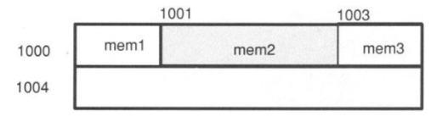
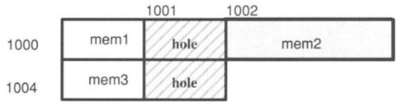
Structure Alignment
structure ALIGN_EXAMP{ char mem1; short mem2; char mem3; } s1;
If the computer has no alignment restrictions, s1 would be stored as:
If the computer requires objects larger than a char to be stored at even addresses, s1 would be stored as:
*This storage arrangement results in a I-byte hole between mem1 and mem2 and following mem3.

Slide 199
Bit fields
The smallest data type that C supports is char(8 bits)
But in structures, it is possible to declare a smaller object called a bitfield.
Bit fields behave like other int variables, except that:
You cannot take the address of a bit field and
You cannot declare an array of bit fields.

Slide 200
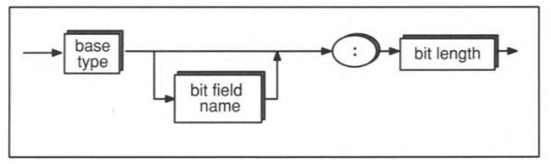
Bit fields
Syntax:
The base type may be int, unsigned int, or signed int.
If the bit field is declared as int, the implementation is free to decide whether it is an unsigned int or a signed int (For portable code, use the signed or unsigned qualifier).
The bit length is an integer constant expression that may not exceed the length of an int.
On machines where ints are 16 bits long, e.g. the following is illegal: int too_long: 17;

Slide 201
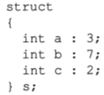
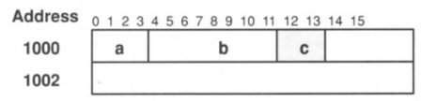
Bit fields
Assuming your compiler allocates 16-bits for a bit field, the following declarations would cause a, b, and c to be packed into a single 16-bit object:
PS: Each implementation is free to arrange the bit fields within the object in either increasing or decreasing order, depending on the compiler

Slide 202
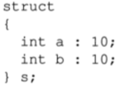
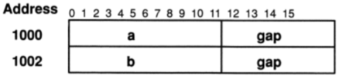
Bit fields
If a bit field would located in an int boundary, a new memory area may be allocated, depending on your compiler. For instance, the declaration might cause a new 16-bit area of memory to be allocated for b:

Slide 203
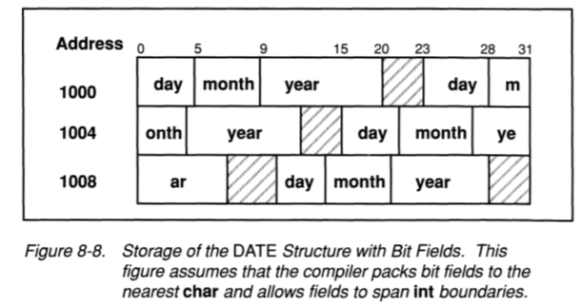
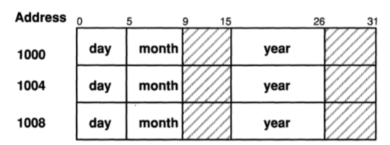
Bit fields
Consider DATE structure example:
struct DATE{
unsigned int day : 5;
unsigned int month : 4;
unsigned int year : 11;
};
Alternative Storage of the DATE Structure with Bit Fields. The left figure assumes that the compiler packs bit fields to the nearest short and does not allow fields to span int boundaries.
It can be seen that, in order to ensure optimum memory allocation, you need to know some details of your environment but you can always take some precautions by: changing the order of your fields, allocating a few extra bits in order to save more memory, etc.

Slide 204
Example: A Struct having a bit field
Let’s keep employment dates of employees:
struct personalstat {
char ps_name[20], ps_tcno[11];
unsigned int ps_birth_day : 5;
unsigned int ps_birth_month : 4;
unsigned int ps_birth_year : 11;
// pointer to the next element in the linked list:
struct personalstat *next;
};
// ELEMENT becomes synonymous with struct personalstat:
typedef struct personalstat ELEMENT;
// Always keep a pointer to the beginning of the linked list
static ELEMENT *head;

Slide 205
Example: A Struct having a bit field
The rest will be very similar to our previous example:
void printElementP( ELEMENT *emp ) {
printf("Employee %s %s born in %d.%d.%d\n", emp->ps_tcno, emp->ps_name,
emp->ps_birth_day, emp->ps_birth_month, emp->ps_birth_year );
}
void printList( ) {
int j; ELEMENT *p;
for(j=0, p=head; p != NULL; p=p->next, j++)
printf("%d-th person: %s\t%s\t%u.%u.%u\n", j+1, p->ps_name, p->ps_tcno,
p->ps_birth_day, p->ps_birth_month, p->ps_birth_year);
}
ELEMENT *create_list_element(){
ELEMENT *p;
int val; //ilkel ve bitfield olduğu için geçici değişken şart
p=(ELEMENT*) malloc (sizeof (ELEMENT));
if(p == NULL) { printf("create_list_element (): malloc failed. \n"); exit(1); }
printf("Enter name of the person:"); scanf("%s", p->ps_name);
printf("Enter tcno of the person:"); scanf("%s", p->ps_tcno);
printf("Enter the birth-date (day) of the person:"); scanf("%u", &val); p->ps_birth_day=val;
printf("Enter the birth-date (month) of the person:"); scanf("%u", &val); p->ps_birth_month=val;
printf("Enter the birth-date (year) of the person:"); scanf("%u", &val); p->ps_birth_year=val;
p->next=NULL; return p;
}
void add_element(ELEMENT *e){
ELEMENT *p;
if(head==NULL){ head=e; return; }
for (p=head; p->next != NULL; p=p->next); // null statement
p->next=e;
}

Slide 206
Example: A Struct having a bit field
The rest will be very similar to our previous example :
void insert_after(ELEMENT *p, ELEMENT *q){
// if p and q are same or NULL, or if p already follows q, report that:
if(p==NULL || q==NULL || p==q || q->next == p){
printf("insert_after(): Bad arguments \n");
return;
}
p->next = q->next;
q->next = p;
}
void delete_element(ELEMENT *goner){
ELEMENT *p;
if(goner == head)
head=goner->next;
else // find element preceding the one to be deleted:
for(p=head; (p!=NULL) && (p->next != goner); p=p->next); // null statement
if(p == NULL){
printf("delete_element(): could not find the element \n"); return;
}
p->next=p->next->next;
free(goner);
}
ELEMENT *find( char * name){
ELEMENT *p;
for(p=head; p!= NULL; p=p->next)
if(strcmp(p->ps_name, name) == 0) // returns 0, if 2 strings are same
return p;
return NULL;
}

Slide 207
Example: A Struct having a bit field
The rest will be very similar to our previous example :
int main(){
ELEMENT *p,*q;
int val, j;
for(j=0; j<2; j++)
add_element( create_list_element());
for(j=0, p=head; p != NULL; p=p->next, j++) //for(p=head; p != NULL; p=p->next)
{
//printf("%d-th person: %s\t%s\t%u.%u.%u\n", j+1, p->ps_name, p->ps_tcno, p->ps_birth_day, p->ps_birth_month, p->ps_birth_year);
printf("%d-th person: ",(j+1)); printElementP(p);
}
// CREATE A NEW ELEMENT AND INSERT IT IN BETWEEN THE 1st AND 2nd ELEMENTS IN THE LIST:
p=create_list_element();
q=head; // to keep the first element, head and we'll insert p, after q:
insert_after(p, q);
printList( );
return 0;
}

Slide 208
Unions
Unions are similar to structures except that the members are overlaid one on top of another, so members share the same memory.
There are two basic applications for unions:
Interpreting the same memory in different ways.
Creating flexible structures that can hold different types of data.

Slide 209
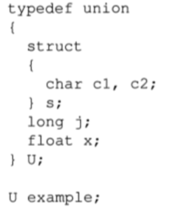
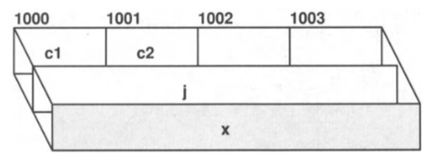


Unions
Example:
Usage:
If you make the assignment:
example.j = 5; //overwrites the 2 chars, using all 4 bytes to store value 5.

Slide 210
Real life example for Unions in Structures
Consider our PERSONALSTAT example (name, tcno, birth_date), we want to add additional information as follows:
Are you T.C. citizen?
If you are a T.C. citizen, in which city were you born?
If not a T.C. citizen, what is your nationality?
typedef struct {
unsigned int day : 5;
unsigned int month : 3;
unsigned int year : 11;
} DATE;
typedef struct {
char ps_name[20], ps_tcno[11];
DATE ps_birth_date;
// Bit field for TC citizenship:
unsigned int TCcitizen : 1;
char nationality[20];
char city_of_birth[20];
} PERSONALSTAT;
This definition wastes memory in each record for either nationality or city_of_birth.

Slide 211
Real life example for Unions in Structures
Let’s construct a better struct with a union so that we eliminate unnecessary waste of memory:
typedef struct {
unsigned int day : 5;
unsigned int month : 4;
unsigned int year : 11;
} DATE;
typedef struct {
char ps_name[20], ps_tcno[11];
DATE ps_birth_date;
unsigned int TCcitizen : 1;
union{
char nationality[20];
char city_of_birth[20];
} location;
} PERSONALSTAT;

Slide 212
Recursion
Structural Programming
by Zeyneb YAVUZ
Corrections and additions
by Yunus Emre SELÇUK

Slide 213
Recursion
void recurse () {
static count = 1;
printf(“%d\n”, count);
count++;
recurse();
}
main() {
recurse();
}
A recursive function is one that calls itself.
An example is given on the right side
It is important to notice that this function will call itself forever.
Actually not forever, but till the computer runs out of stack memory
It means a runtime error
Thus, remember to include a stop point in your recursive functions.

Slide 214
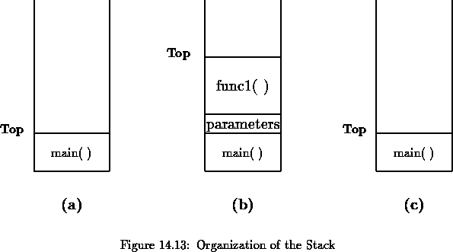
Recursion
When a program begins executing in the function main(), space is allocated on the stack for all variables declared within main(), Figure 14.13(a)
If main() calls a function, func1(), additional storage is allocated for the variables in func1() at the top of the stack Figure 14.13(b)
Notice that the parameters passed by main() to func1() are also stored on the stack.
When func1() returns, storage for its local variables is deallocated, and the top of the stack returns to the 1st position Figure 14.13(c)
As can be seen, the memory allocated in the stack area is used and reused during program execution.
It should be clear that memory allocated in this area will contain garbage values left over from previous usage.

Slide 215
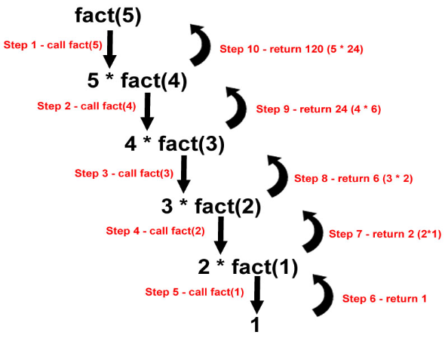
Recursion Example: Factorial Calculation
int fact( int n ) {
if( n <= 1 )
return 1;
else
return n*fact(n-1);
}
main() {
printf("5! is %d\n", fact(5));
}
A few other examples to solve with recursion (left as exercises at home):
Fibonacci numbers – F_{n+1} = F_{n} + F_{n-1}
Binary search
Depth-first search

Slide 216
Function Pointers
Structural Programming
by Zeyneb YAVUZ
Corrections and additions
by Yunus Emre SELÇUK

Slide 217
Function Pointers
We can use some functions as arguments to other functions through the function pointers
This possibility opens new doors in terms of flexibility for coding.
Definition:
int (*pf) (); // pf is a pointer to a function returning an int.
The () around *pf are necessary for correct grouping. Because:
int *pf(); // this is a function allusion returning an int pointer

Slide 218
Function Pointers
Assignments to function pointers:
extern int f1();
int main( ) {
int (*pf) (); // pf is a pointer to a function returning an int.
pf=f1; // assign the address of f1 to pf
pf=f1(); // ILLEGAL, f1 returns an int, but pf is a pointer
pf=&f1(); /* ILLEGAL, cannot take the address of a function result */
pf=&f1; /* ILLEGAL but compiler dependent:
&f1 is a pointer to a pointer, but pf
is a pointer to an int */
}

Slide 219
Function Pointers
Return types:
extern int if1(), if2(), (*pif)();
extern float ff1(), (*pff)();
extern char cf1(), (*pcf)();
int main( ) {
pif = if1; // Legal: Types match
pif = cf1; // ILLEGAL: Type mismatch
pff = if2; // ILLEGAL: Type mismatch
pcf = cf1; // Legal: Types match
if1 = if2; // ILLEGAL: Assign to a constant
}

Slide 220
Function Pointers
Example function call via a function pointer:
#include <stdio.h>
extern int f1(int); //could be defined externally but we have coded it below
int main() {
int n;
int (*pf) ();
int answer;
printf("Bir sayi giriniz: "); scanf("%d",&n);
pf=f1;
answer=(*pf)(n); // calls f1() with argument a => f1(a)
printf("%d", answer);
return 0;
}
int f1( int a ) {
return a+1;
}

Slide 221
Bu yansı ders notlarının düzeni için boş bırakılmıştır.

Slide 222
File Input-Output (I/O)
Structural Programming
by Zeyneb YAVUZ
Corrections and additions
by Yunus Emre SELÇUK and Ahmet ELBİR

Slide 223
Input and Output (I/O)
Operating systems (OSs) vary greatly in the way they allow access to data in files and devices.
This variation makes it extremely difficult to design I/O programs that are portable.
The C language performs I/O through a large set of runtime routines. Some of these functions were derived from the UNIX I/O library.
However:
The "C library" deals mostly with buffered I/O while the UNIX library performs unbuffered I/O.
The UNIX OS treats binary and text files the same. In some other OSs, the distinction is extremely important.
ANSI Committee preserved, deleted, and modified some functions:
The biggest change is: elimination of unbuffered I/O functions. In the ANSI library, all I/O functions are buffered, still you can change the buffer size.
The ANSI I/O functions make a distinction between accessing files in binary or text mode (to be examined in more detail shortly).

Slide 224
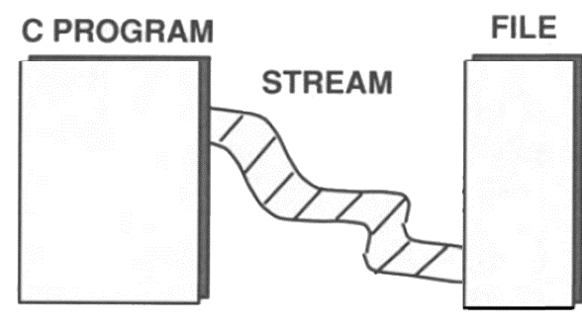
I/O and Streams
C makes no distinction between devices such as a terminal or tape drive or files on a disk.
In all cases, I/O is performed through streams that are associated with the files or devices.
A stream consists of an ordered series of bytes (such as a one-dimensional array of characters, as shown in the Figure).
Reading and writing to a file or device involves reading data from the stream or writing data onto the stream.
To perform I/O operations, you must associate a stream with a file or a device.
You do this by declaring a pointer to a structure type called FILE.
The FILE structure, will be examined later in more detail.

Slide 225
Standard Streams
There are three default streams that are automatically opened for every program:
stdin, stdout and stderr.
Usually, these streams point to your terminal, but many operating systems permit you to redirect them (eg you might want error messages written to a file instead of the terminal).
The I/O functions already introduced, eg printf() and scanf(), use these default streams.
printf() writes to stdout, and scanf() reads from stdin.
You could use these functions to perform I/O to files by making stdin and stdout point to files (with the freopen() function).
However an easier method is to use the equivalent functions, fprintf() and fscanf(), which enable us to specify a particular stream.

Slide 226
Text and Binary Formats
Data can be accessed in one of two formats: text or binary.
A text stream consists of a series of lines, where each line is terminated by a newline (‘\n’) character.
However, OSs may have other ways of storing lines on disks, so each line in a text file does not necessarily end with a newline character.
E.g. many IBM systems, keep track of text lines through an index of pointers to the beginning of each line.
In this scheme, the files stored on disk or tape may not contain newline characters even though they are logically composed of lines.
However, when these lines are read into memory in text mode, the runtime functions automatically insert newlines into the text stream.

Slide 227
Text Format
When lines are written from/to a text stream, the I/O functions may replace new lines in the stream with implementation-defined characters that get written to the I/O device.
In this way, C text streams have a consistent appearance from one environment to another, even though the format of the data on the storage devices may vary.
Despite this rule that promotes portability somewhat, be extremely careful when performing textual I/O: Programs that work on one system may not work exactly the same way on another.
In particular, the rules described above hold true only for printable characters (e.g. tabs, form feeds, and newlines).
If control characters (non-printable characters) appear in a text stream, they are interpreted in an implementation-defined manner.

Slide 228
Binary Format
In binary format, the compiler performs no interpretation of bytes. It simply reads and writes bits exactly as they appear.
Binary streams are used primarily for non-textual data, where there is no line structure and it is important to preserve the exact contents of the file.
If you are more interested in preserving the line structure of a file, you should use a text stream.
The 3 standard streams (stdin, stdout, stderr) are all opened in text mode.
In UNIX environments the distinction between text and binary modes is superficial since UNIX treats all data as binary data.
However, even when programming in a UNIX environment, you should beware of potential difficulties in porting to other systems

Slide 229
Using Streams via the FILE Structure
To perform I/O operations, you must associate a stream with a file or a device.
You do this by declaring a pointer to a structure type called FILE.
The FILE structure, which is defined in the stdio.h header file, contains several fields to hold such information as the file's name, its access mode, and a pointer to the next character in the stream.
These fields are assigned values when you open the stream and access it, but they are implementation dependent, so they vary from one system to another.
The FILE structures provide the OS some metadata information, but our only chance to access to the stream is the pointer to the FILE structure (called a file pointer).

Slide 230
Using Streams via the FILE Structure
The file pointer, which you must declare in your program, holds the stream identifier returned by the fopen() function.
You use the file pointer to read from, write to, or close the stream.
A program may have more than one stream open simultaneously, although each implementation imposes a limit on the number of concurrent streams.
One of the fields in each FILE structure is a file position indicator that points to the byte where the next character will be read from or written to.
As you read from or write to the file, the OS adjusts the file position indicator to point to the next byte.

Slide 231
Using Streams via the FILE Structure
Although you can't directly access the file position indicator (at least not in a portable fashion), you can fetch and change its value through library functions, thus enabling you to access a stream in non-serial order.
Do not confuse the file pointer with the file position indicator:
The file pointer identifies an open stream connected to a file or device.
The file position indicator refers to a specific byte position (i.e. next character) within a stream

Slide 232
The <stdio.h> Header File
To use any of the I/O functions, include the stdio.h, which contains:
Prototype declarations for all the I/O functions.
Declaration of the FILE structure.
Several useful macro constants, including stdin, stdout, stderr, EOF, and NULL.
stdin, stdout, stderr: Standard streams
EOF: The value returned by many functions when the system reaches the end-of-file marker.
NULL: The name for a null pointer. It can be defined in another header file called stddef.h.
To use NULL, you must either include stdio.h or stddef.h

Slide 233
Opening a File: fopen function
Before you can read from or write to a file, you must open it with the fopen() function.
fopen() takes 2 arguments:
1st parameter is the file name
2nd parameter is the access mode
There are two sets of access modes:
One for text streams and
One for binary streams.

Slide 234
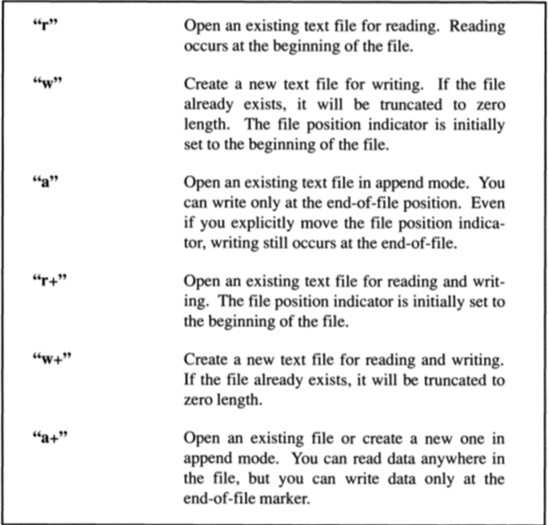
Opening a File: fopen function
Access modes for text streams is on the right side.
The binary modes are exactly the same, except that they have a “b” appended to the mode name.
For example to open a binary file with read access you would use "rb".

Slide 235
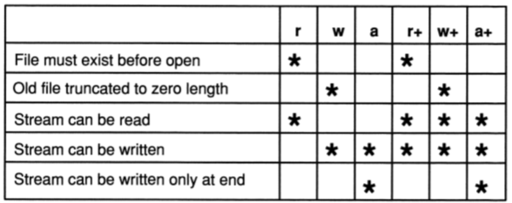
Opening a File: fopen function
File and Stream properties of fopen() modes:

Slide 236
Opening a File: fopen function
fopen() returns a file pointer of type FILE that you can use to access the file later in the program (check the example code).
fopen() returns a null pointer (NULL) if an error occurs.
If successful, fopen() returns a non-zero file pointer.
fprintf() is exactly like printf(), except that it takes an extra argument indicating which stream the output should be sent to.

Slide 237
I/O Operations: Reading and Writing Data
Once you have opened a file, you use the file pointer to perform read and write operations.
There are three ways to perform I/O operations on three different sizes of objects:
One character at a time: getc and putc functions
One line at a time: fgets and fputs functions
One block at a time: fread and fwrite functions
Each of these methods has some pros and cons that will be discussed later.

Slide 238
I/O Operations: Reading and Writing Data
One rule that applies to all levels of I/O is:
You cannot read from a stream and then write to it without an intervening call to fseek(), rewind(), or fflush().
The same rule holds for switching from write mode to read mode.
These three functions are the only I/O functions that flush the buffers.
If you do not have memory shortage, you can read from input the stream, construct and keep the output data in the memory and finally write to the output stream
The input and output streams can point to the same file, but close the file that you have read before writing to it.

Slide 239
Closing a File: fclose function
To close a file, you need to use the fclose() function: fclose( fp );
Closing a file frees up the FILE structure that fp points to so, the OS can use the structure for a different file.
It also flushes any buffers associated with the stream.
Most OSs have a limit on the number of streams that can be open at once, so it's a good idea to close files when you're done with them.
In any event, all open streams are automatically closed when the program terminates normally.
Most OSs will close open files even when a program aborts abnormally, but you can't depend on this behavior.

Slide 240
I/O Example #1: Copy operation
Reading and writing one character at a time in binary mode:
When the end-of-file is encountered, the feof() function returns a non-0 value
#include <stdio.h>
#define FAIL 0
#define SUCCESS 1
int copyfile(char * infile, char * outfile){
FILE *fp1, *fp2;
if ((fp1 = fopen(infile, "rb" )) == NULL) {
printf("Could not open the input file\n"); return FAIL;
}
if ((fp2=fopen (outfile, "wb" )) == NULL) {
printf("Could not open the output file\n"); fclose( fp1 ); return FAIL;
}
while (!feof( fp1 ))
putc( getc(fp1), fp2 );
fclose(fp1); fclose(fp2); return SUCCESS;
} //to be continued with the main method

Slide 241
I/O Example #1: Copy operation
More on how to determine EOF:
we cannot use the return value of getc() to test for an end-of-file character because the file is opened in the binary mode.
For example, if we wrote:
int c;
while ((c = getc( fp1 )) != EOF)
putc( getc(fp1), fp2 );
the loop will exit whenever the character read has the same value as EOF.
This may or may not be a true end-of-file condition in binary files.
Only the feof() function will exactly provide us to check if we reach the enf-of-file.

Slide 242
I/O Example #1: Copy operation
The rest of the example:
int main(){
char infl[100], outfl[100];
int result;
printf("enter name of the input file\n"); scanf("%s", infl);
printf("enter name of the output file\n"); scanf("%s", outfl);
result=copyfile(infl, outfl);
if(result == SUCCESS)
printf("input file is copied to the output file \n");
if(result == FAIL)
printf("input file could not be copied to the output file \n");
return 0;
}

Slide 243
Character I/O:
Four functions that read and write one character to a stream:
getc() A macro that reads one character from a stream.
fgetc() Same as getc(), but implemented as a function.
putc() A macro that writes one character to a stream.
fputc() Same as putc(), but implemented as a function.
getc() and putc() are usually implemented as macros whereas fgetc() and fputc() are guaranteed to be functions.
Because putc and getc are implemented as macros, they usually run much faster. They are almost twice as fast as fgetc and fputc
However since they are macros, they are susceptible to side effect problem e.g. this is a dangerous call that may not work as expected: putc( ’x', fp[j++] );
If an argument contains side effect operators, you should use fgetc() or fputc(), which are guaranteed to be implemented as functions.

Slide 244
I/O Example #2: Copy operation
Reading and writing one line at a time in text mode:
#include <stdio.h>
//#include <stddef.h>
#define FAIL 0
#define SUCCESS 1
#define LINESIZE 100
int copyfile(char * infile, char * outfile){
FILE *fp1, *fp2; char line[LINESIZE];
if ((fp1 = fopen(infile, "r" )) == NULL) {
printf("Could not open the input file\n"); return FAIL;
}
if ((fp2=fopen (outfile, "w" )) == NULL) {
printf("Could not open the output file\n"); fclose( fp1 ); return FAIL;
}
while (fgets ( line, LINESIZE-1, fp1 ) != NULL)
fputs( line, fp2 );
fclose(fp1); fclose(fp2); return SUCCESS;
} //the main method will be the same as the previous example
The difference is in the while loop and its body

Slide 245
Line I/O:
There are two line-oriented I/0 functions-fgets() and fputs().
The prototype for fgets() is: char *fgets( char *s, int n, FILE stream );
The three arguments of fgets():
s: A pointer to the 1st element of an array to which characters will be written.
N: An integer representing the max number of characters to read.
stream The stream from which to read.
fgets() reads characters until it reaches a newline, or the end-of-file, or the maximum number of characters specified.
fgets() automatically inserts a null character after the last character written to the array.
So, we specify the “n” parameter to be one less than the “s” array #.
fgets() returns NULL when it reaches the end-of-file.
Otherwise, it returns the first argument (“s” string).

Slide 246
Line I/O:
The prototype for fputs() is: fputs(char *s, FILE stream)
fputs() writes the array identified by the 1st argument to the stream identified by the 2nd argument.
In the code example, copying a binary file with line I/O produced a corrupt file.
fgets() vs gets():
gets() is the function that reads lines from stdin.
Both functions append a null character (‘\0’) after the last character written.
However, gets() does not write the terminating newline character to the input array. fgets() does include the terminating newline character (or an EOF if it just got the last line of the file).
Also, fgets() allows you to specify a maximum number of characters to read, whereas gets() reads characters indefinitely until it encounters a newline or EOF.

Slide 247
Block I/O:
We can also access data in lumps called blocks, where each block is stored in an array.
When you read or write a block, you need to specify the number of elements in the block and the size of each element.
The two block I/O functions are: fread() and fwrite().
size_t fread(void *ptr, size_t size, size_t nmemb, FILE *stream);
void fwrite(void *ptr, size_t size, size_t nmemb, FILE *stream);
size_t: an integer type defined in stdio.h
ptr: A pointer to an array (mostly char), in which to store data.
size The size of each element in the array.
nmemb The number of elements to read.
stream The file pointer.

Slide 248
Block I/O:
fread() returns the number of elements actually read, which should be the same as the 3rd argument unless an error occurs or an EOF condition is encountered.
The fwrite() is the mirror of fread(), takes the same arguments, but instead of reading elements from the stream to the array, it writes elements from the array to the stream.
The block sizes in fread() and fwrite(), do not affect the number of device I/O operations performed
The buffer size, for instance, might be 1024 bytes. If the block size specified in a read operation is only 512 bytes, the OS will still fetch 1024 bytes from the disk and store them in memory.
But, only the first 512 bytes will be available to the fread().
On the next fread() call, the OS will fetch the remaining 512 bytes from memory rather than performing another disk access.

Slide 249
I/O Example #2: Copy operation
Reading and writing by blocks in binary mode:
#include <stdio.h>
#include <stddef.h>
#define FAIL 0
#define SUCCESS 1
#define BLOCKSIZE 512
typedef char DATA;
//continued in the next slide

Slide 250
I/O Example #2: Copy operation
Reading and writing by blocks in binary mode:
int copyfile(char * infile, char * outfile){
FILE *fp1, *fp2; int num_read; char block[BLOCKSIZE];
if ((fp1 = fopen( infile, "rb" )) == NULL){
printf( "Error opening file %s for input.\n", infile ); return FAIL;
}
if ((fp2 = fopen( outfile, "wb" )) == NULL){
printf( "Error opening file %s for output.\n", outfile );
fclose(fp1); return FAIL;
}
while ((num_read = fread( block, sizeof(DATA), BLOCKSIZE, fp1 )) == BLOCKSIZE)
fwrite( block, sizeof(DATA), num_read, fp2 );
fwrite( block, sizeof(DATA), num_read, fp2 ); //notice this line!
fclose(fp1); fclose(fp2);
if (ferror(fp1)) { printf( "Error reading file %s\n", infile ); return FAIL; }
return SUCCESS;
} //the main method will be the same as the previous example

Slide 251
Random Access:
So far we accessed files sequentially, beginning with the 1st byte and accessing each successive byte in order.
For some applications this can be reasonable.
However, for some applications, you need to access particular bytes in the middle of the file.
In this case, we use 2 random access functions: fseek() and ftell().

Slide 252
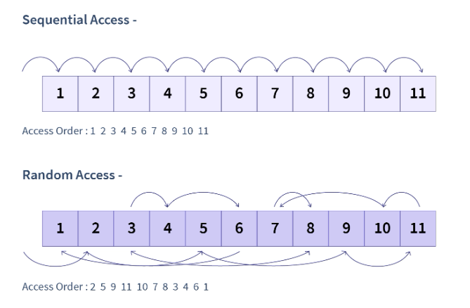
Random Access:

Slide 253
Random Access: fseek
The fseek() moves the file position indicator to a specified character in a stream:
int fseek( FILE *stream, long int offset, int whence);
stream: A file pointer
offset: An offset measured in characters (can be negative).
Binary: # of bytes.
Text: Either 0, or a value returned by ftell().
whence: The starting position from which to count the offset.
3 choices for whence (defined in stdio.h):
SEEK_SET: The beginning of the file.
SEEK_CUR: The current position of the file position indicator
SEEK_END: The end-of-file position.

Slide 254
Random Access: fseek
For example: stat = fseek(fp, 10, SEEK_SET);
Moves the file position indicator to character 10 of the stream. This will be the next character read or written.
Streams, like arrays, start at the 0-th position, so character 10 is actually the 11-th character in the stream.
The value returned by fseek() is 0 if the request is legal. Otherwise, it returns a non-0 value.
This can happen for a variety of reasons, the following is illegal if fp is opened for read-only access because it attempts to move the file position indicator beyond the end-of-file position: stat = fseek(fp, 1, SEEK_END)
If SEEK_END is used with read-only files, the offset value must be less than or equal to 0.
Similarly, if SEEK_SET is used, the offset value must be greater than or equal to 0.
Do not push the file position indicator out of the file

Slide 255
Random Access: ftell
The ftell() takes just one argument, which is a file pointer, and returns the current position of the file position indicator.
ftell() is used to return to a specified file position after performing one or more I/O operations
The position returned by ftell() is measured from the beginning of the file:
For binary streams, the value returned by ftell() represents the actual number of characters from the beginning of the file.
For text streams, the value returned by ftell() represents an implementation-defined value that has meaning only when used as an offset to an fseek() call.

Slide 256
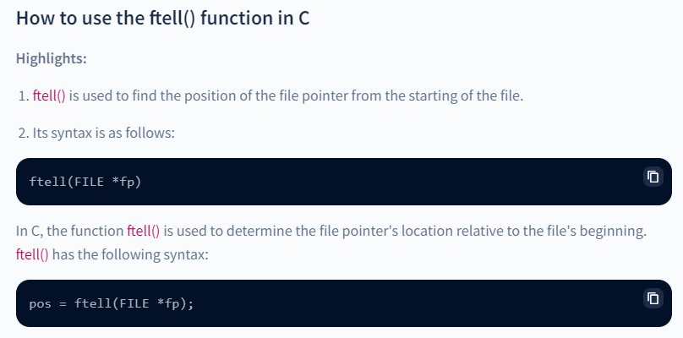
Ftell.c

Slide 257
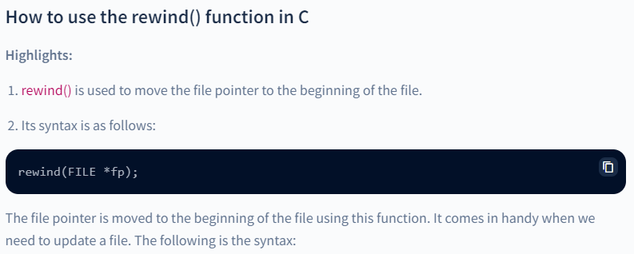
Rewind.c

Slide 258
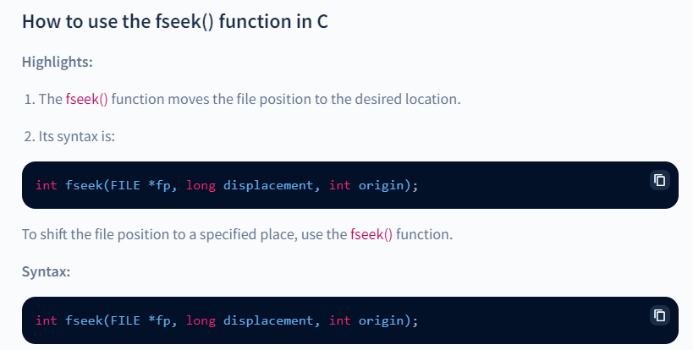
fseek.c

Slide 259
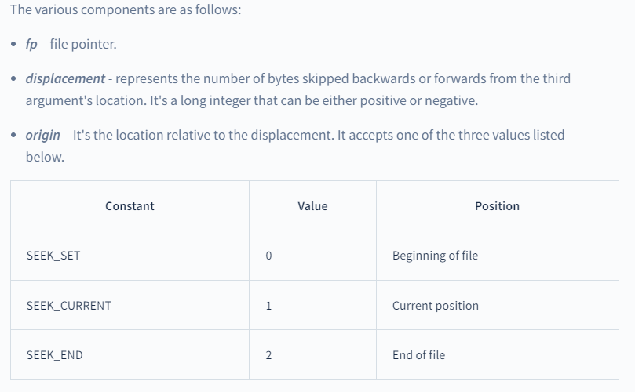

Slide 260
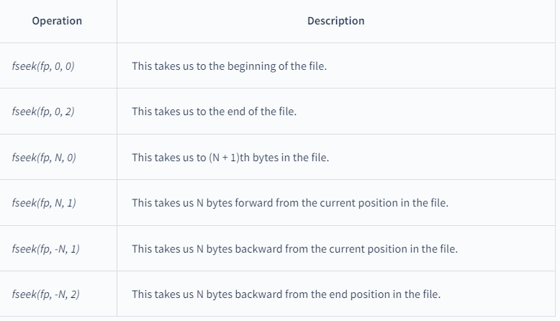

Slide 261
Random Access Example
Consider a large data file composed of records, where each record is a PERSONALSTAT structure, as declared earlier weeks.
Suppose that the records are arranged randomly, but we want to print them alphabetically by the surname field. First, you need to sort the records.
We want to avoid sorting as it will take a lot of time and I/O operations.
Instead of sorting, let’s create an index and sort only the index

Slide 262
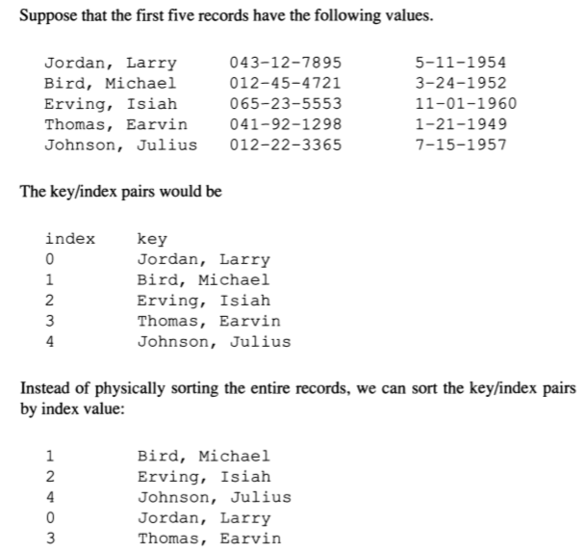
Random Access Example

Slide 263
Random Access Example
Let’s create the data file first:
#include <stdio.h>
typedef struct {
unsigned int day : 5;
unsigned int month : 4;
unsigned int year : 11;
} DATE;
typedef struct {
char ps_name[19], ps_tcno[11];
DATE ps_birth_date;
} PERSONALSTAT;
//to be continued in the next slide

Slide 264
Random Access Example
int main(){
int j; FILE *fp; unsigned int val;
PERSONALSTAT ps2[4];
fp=fopen("records.dat", "wb");
for(j=0; j<4; j++){
printf("Enter name of the %d-th person:\n", j+1);
scanf("%s", ps2[j].ps_name);
printf("Enter tcno of the %d-th person:\n", j+1);
scanf("%s", ps2[j].ps_tcno);
printf("Enter the birth-date (day) of the %d-th person:\n", j+1);
// NOT ALLOWED: scanf("%u", &ps2[j].ps_birth_date.day);
scanf("%u", &val); ps2[j].ps_birth_date.day=val;
printf("Enter the birth-date (month) of the %d-th person:\n", j+1);
scanf("%u", &val); ps2[j].ps_birth_date.month=val;
printf("Enter the birth-date (year) of the %d-th person:\n", j+1);
scanf("%u", &val); ps2[j].ps_birth_date.year=val;
fwrite(&ps2[j], sizeof(PERSONALSTAT), 1, fp);
}
fclose(fp); return 0;
}

Slide 265
Random Access Example
Now let’s create and sort the index:
#include <stdio.h>
#include <stddef.h>
#include <stdlib.h> // Header file for qsort()
#include <string.h> // for the strcmp function()
#define MAX_REC_NUM 1000
#define NAME_LEN 19
typedef struct {
unsigned int day : 5;
unsigned int month : 4;
unsigned int year : 11;
} DATE;
typedef struct {
char ps_name[NAME_LEN], ps_tcno[11];
DATE ps_birth_date;
} PERSONALSTAT;
// structure definition for the index files for our records:
typedef struct {
int index;
char key[NAME_LEN];
} INDEX;
//to be continued in the next slide

Slide 266
Random Access Example
/* Reads up to max_rec_num records from a file and stores the key field of each record in an index array. Returns the number of key fields stored. */
int get_records(FILE* data_file, INDEX names_index[], int max_rec_num){
int offset = 0, counter = 0, k, nm = NAME_LEN;
char namei[NAME_LEN];
// get only the name of the 1st PERSON: (the first 19 chars is for name field)
nm=fread(namei, 1, NAME_LEN, data_file);
for (k = 0; counter < max_rec_num && nm== NAME_LEN; k++){
strcpy(names_index[k].key, namei);
// jump into the beginning of the next person's (next record's) starting point:
offset += sizeof(PERSONALSTAT);
fseek(data_file, offset, SEEK_SET);
counter++;
// get only the name of the i-th PERSON: (the first 19 chars for each person/record)
nm=fread(namei, 1, NAME_LEN, data_file);
}
return counter;
}
//to be continued in the next slide

Slide 267
Random Access Example
/* Sort an array of NAMES_INDEX structures by the name field. There are index count elements to be sorted. Returns a pointer to the sorted array. This function will be required for the qsort function to provide a means of comparison. */
int compare_func(INDEX *p, INDEX *q ){
return strcmp( p->key, q->key);
/* <0: the first character that does not match has a lower value in ptr1 than in ptr2
0: the contents of both strings are equal
>0: the first character that does not match has a greater value in ptr1 than in ptr2 */
}
void sort_index(INDEX names_index[], int index_count) {
int j;
int (*pf) (); pf = compare_func;
// Assign values to the index field of each structure:
for (j = 0; j < index_count; j++)
names_index[j].index = j;
qsort(names_index, index_count, sizeof(INDEX), pf);
}
//to be continued in the next slide

Slide 268
Random Access Example
/* Print the records in a file in the order * indicated by the index array. */
void print_indexed_records(FILE * data_file, INDEX index[], int index_count ){
PERSONALSTAT ps;
int j;
for (j = 0; j < index_count; j++){
if (fseek( data_file, sizeof(PERSONALSTAT) * index[j].index, SEEK_SET))
exit( 1 );
fread(&ps, 1, sizeof(PERSONALSTAT), data_file);
printf( "%20s, %u, %u, %u, %12s\n", ps.ps_name, ps.ps_birth_date.day,
ps.ps_birth_date.month, ps.ps_birth_date.year, ps. ps_tcno);
}
}
//to be continued in the next slide

Slide 269
Random Access Example
/* To make this program complete, we need a main() function that calls these other functions. We have written main() so the filename can be passed as an argument.*/
int main(int argc, char *argv[]){
FILE *data_file, *index_file; static INDEX index[MAX_REC_NUM]; int num_recs_read; char *filename;
if (argc < 2) {
printf( "Error: must enter index filename\n" );
printf( "Filename: " ); filename=malloc(60); scanf( "%s", filename );
}
else filename = argv[1];
if ((data_file = fopen( filename, "rb" )) == NULL){
printf( "Error opening file %s.\n", filename); exit(1);
}
num_recs_read = get_records(data_file, index, MAX_REC_NUM ) ;
printf("num_recs_read: %d\n", num_recs_read);
sort_index(index, num_recs_read);
printf("After the sorting\n");
print_indexed_records (data_file, index, num_recs_read);
fclose(data_file);
return 0;
}

Slide 270
File Management Functions
remove(): Deletes a file
int remove (const char* szFileName);
rename(): Renames a file
int rename (const char* szOldFileName, const char* szNewFileName);
tmpfile(): Creates a temporary binary file
FILE* tmpfile ();
tmpnam():
char* tmpnam (char caName[]);
Generates a string that can be used as the name of a temporary file. Can return unsafe characters such as \s therefore it should be sanitized.

Slide 271
Splitting a Program & Makefile
Multithread Programming
by Zeyneb YAVUZ and Ahmet ELBİR

Slide 272
Splitting Your C Program
At least one of the files must have a main() function.
To use functions from another file,
make a .h file with the function prototypes,
and use #include to include those .h files within your .c files.
Be sure no 2 files have functions with the same name in it.
The compiler will get confused.
Similarly, if you use global variables in your program, be sure no two files define the same global variables.

Slide 273
Splitting Your C Program
If you use global variables, be sure only one of the files defines them, and declare them in your .h as follows:
extern int globalvar;
When you define a variable, it looks like this:
int globalvar;
When you declare a variable, it looks like this:
extern int globalvar;
The main difference is that a variable definition creates the variable, while a declaration indicates that the variable is defined elsewhere. A definition implies a declaration.
REMINDER!!

Slide 274
An EXAMPLE
salute.h (header file contains prototypes):
#ifndef __salute_h__
#define __salute_h__
void salute( void );
#endif
main.c :
#include <stdio.h>
#include “salute.h”
int main ( void ) {
salute();
return 0;
}
salute.c (implement the .h in a .c file):
#include <stdio.h>
void salute( void ) {
printf(“\n\n HELLO!!! \n\n”);
}
cc -c salute.c #this will give you salute.o
cc -c main.c #this will give you main.o
cc -o main main.o salute.o #this will create the main executable

Slide 275
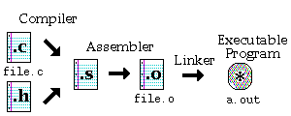
Compiling with Several Files
The command to perform this task is simply
gcc file.c
There are 3 steps to obtain the final executable program
Compiler stage
Assembler stage
Linker stage
Side-note: pre-processor takes place before the compiler stage

Slide 276
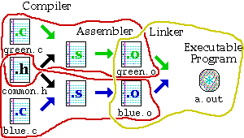
Compiling with Several Files
You can use the -c option with gcc to create the corresponding object (.o) file from a .c file.
gcc -c green.c
will not produce an a.out file, but the compiler will stop after the assembler stage, leaving you with a green.o file.

Slide 277
Compiling with Several Files
The three different tasks required to produce the executable program are as follows:
Compile green.o:
gcc -c green.c
Compile blue.o:
gcc -c blue.c
Link the parts together:
gcc green.o blue.o // will create an exe with the name a.out (by default)
If you want to give another name to your exe, use –o flag

Slide 278
The Make Command
helps you to manage large programs or groups of programs
keeps track of which portions of the entire program have been changed
compiles only those parts of the program which have changed since the last compile.

Slide 279
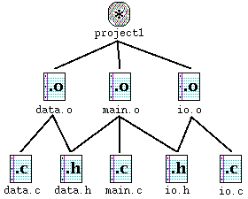
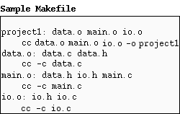
How does make do it?
The make program gets its dependency "graph" from a text file called makefile or Makefile, which resides in the same directory as the source files
make checks the modification times of the files, and whenever a file becomes "newer" than something that depends on it, it runs the compiler accordingly.

Slide 280
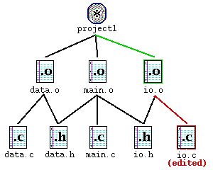
How Dependency Works
Case : while you are testing the program, you realize that one function in io.c has a bug in it.
You edit io.c to fix the bug.
notice that io.o needs to be updated because io.c has changed. Similarly, because io.o has changed, project1 needs to be updated as well.

Slide 281
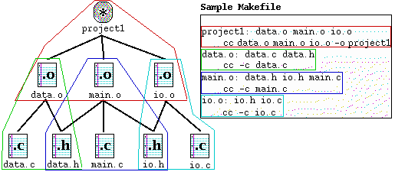
Translating The Dependency Graph
Each dependency shown in the graph is circled with a corresponding color in the Makefile, and each uses the following format:
target : source file(s)
command (must be preceded by a tab)

Slide 282
Listing Dependencies
Note that in the Makefile shown on the right, the .h files are listed, but there are no references in their corresponding commands.
This is because the .h files are referred within the corresponding .c files through the #include "file.h".
If you do not explicitly include these in your Makefile, your program will not be updated if you make a change to your header (.h) files.

Slide 283
Using the Makefile with make
Once you have created your Makefile and your corresponding source files, you are ready to use make.
If you have named your Makefile either Makefile or makefile, make command will recognize it.
If you do not wish to call your Makefile one of these names, you can use make -f mymakefile.

Slide 284
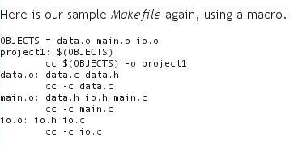
Macros in make
The make program allows you to use macros, which are similar to variables, to store names of files. The format is:
OBJECTS = data.o io.o main.o
Whenever you want to have make expand these macros out when it runs, type the corresponding string $(OBJECTS)

Slide 285
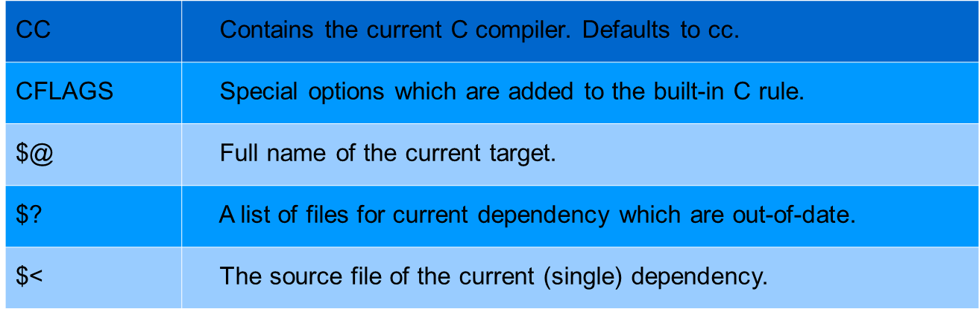
Special macros, which are used by the make program
In addition to those macros which you can create yourself, there are a few macros, which are used internally by the make program. Here are some of those, listed below:

Slide 286
References & more Reading
References
http://www.eng.hawaii.edu/Tutor/Make/index.html
More reading on make command
http://www.cs.duke.edu/~ola/courses/programming/Makefiles/Makefiles.html
http://www.hsrl.rutgers.edu/ug/make_help.html
http://publib.boulder.ibm.com/infocenter/systems/index.jsp?topic=/com.ibm.aix.genprogc/doc/genprogc/make.htm

Slide 287
Multithread Programming
Multithread Programming
by Zeyneb YAVUZ and Ahmet ELBİR

Slide 288
Outline
What is a thread?
Why do we need threads?
Difference between threads and processes
Problems with Threads
Identifying a thread
Creating a thread
Terminating a thread
Examples

Slide 289
Threading in C
Threads/ Processes are the mechanism by which you can run multiple code segments at a time,
A thread of execution is the smallest sequence of program instructions that can be managed independently by a scheduler
A process can have multiple threads of execution.
Threads appear to run concurrently; the kernel schedules them asynchronously, interrupting each thread from time to time to give others chance to execute.
This asynchronous execution brings in the capability of each thread handling a particular work or service independently.
Multiple threads running in a process handle their services which overall constitutes the complete capability of the process.

Slide 290
Use of Threads - Examples
Graphical User Interfaces (GUIs)
The GUI is usually put on a separate thread from the “app engine”
􏰀GUI remains responsive even if app blocks for processing
􏰀Web Browser Tabs
Each tab is managed by a separate thread for rendering
Web pages render “simultaneously” (e.g. while one page is printed out, another page can be downloaded concurrently)
Note: Google Chrome actually uses a separate process per tab

Slide 291
Why Threads are Required?
Why do we need multiple threads in a process? Why can’t a process with only one (default) main thread be used in every situation.
To answer this lets consider an example:
Suppose there is a process, that receiving real time inputs and corresponding to each input it has to produce a certain output.
If the process does not involve multiple threads, then the whole processing in the process becomes synchronous.
This means that the process takes an input, processes it, and produces an output.

Slide 292
Why Threads are Required -2
The limitation in the above design is that the process cannot accept an input until its done processing the earlier one.
In case processing an input takes longer than expected, then accepting further inputs goes on hold.
We could solve the above example with a socket server process that can accept input connection, process them and provide the socket client with output.
While processing any input, if the server process takes more than expected time and in the meantime another input (connection request) comes to the socket server then the server process would not be able to accept the new input connection as its already stuck in processing the old input connection.
This may lead to a connection time out at the socket client which is not at all desired.
This shows that synchronous model of execution cannot be applied everywhere hence the asynchronous model of execution would be required, which is implemented by using threads.

Slide 293
Difference between threads and processes
Processes do not share their memory space, while threads executing under same process share the memory space.
Processes have independent open file descriptors, while threads have shared open file descriptors
Processes execute independent of each other and the synchronization between processes is taken care by kernel only; on the other hand, thread synchronization has to be taken care by the process under which the threads are executing
Context switching between threads is fast as compared to context switching between processes
The interaction between 2 processes is achieved only through the standard inter-process communication, while threads executing under the same process can communicate easily as they share most of the resources like memory, text segment etc

Slide 294
Problems with Threads -1
Many operating system does not implement threads as processes rather they see threads as part of parent process.
What would happen if a thread execs a new binary (exe)?
This scenario may have dangerous consequences e.g. the whole parent process could get replaced with the address space of the newly exec’d binary.
So, an exec from any of the thread would stop all the threads in the parent process. This is not at all desired.
This problem is a design issue and design for applications should be done in a way that least problems of this kind arise.
Debugging with threads is difficult.
Too many threads may reduce the performance.

Slide 295
Problems with Threads -2
Another problem that may arise is the concurrency:
Since threads share all the segments (except the stack) and can be preempted at any stage by the scheduler before any global variable or data structure that can be left in inconsistent state by preemption of one thread could cause severe problems when the next high priority thread executes the same function & uses the same variables or data structures.
For the above problem: using locking mechanisms programmer can lock a chunk of code inside a function so, when a context switch* happens, next thread is not able to execute the same code until the locked code block inside the function is unlocked by the previous thread.
*context switch: is the process of storing the state of a thread, so, it can be restored and execution resumed from the same point later. This allows multiple threads to share a single CPU.

Slide 296
Identifying a thread
Each thread is identified by an ID, which is known as Thread ID
Thread ID is quite different from Process ID.
A Thread ID is unique in the context of current process, while a Process ID is unique across the system.
A process ID is an integer value but the thread ID is not necessarily an integer value. It could be a structure and represented by type pthread_t.
A process ID can be printed very easily while a thread ID is not easy to print.
The header file, which needs to be included to access thread functions and pthread_t type, is: #include<pthread.h>

Slide 297
Creating a Thread ( pthread_create )
pthread_create function in pthread.h file, is used to create a thread.
The syntax and parameters details are given as follows:
int pthread_create(pthread_t *thread, const pthread_attr_t *attr, void * (*start_routine) (void *), void *arg);
pthread_t *thread: It is the pointer to a pthread_t variable which is used to store thread id of new created thread.
const pthread_attr_t *attr: It is the pointer to a thread attribute object which is used to set thread attributes, NULL can be used to create a thread with default arguments.
void *(*start_routine) (void *): It is the pointer to a thread function; this function contains the code segment which is executed by the thread.
void *arg: It is the thread functions argument of the type void*, you can pass what is necessary for the function using this parameter.
int (return type): If thread created successfully, return value will be 0 otherwise pthread_create will return an error number of type int.

Slide 298
Example

Slide 299
#include <stdio.h>
#include <pthread.h>
/*thread (worker) function definition*/
void* threadFunction(void* args){
while(1)
printf("I am threadFunction.\n");
}
int main(){ /*creating a thread id in the main function (main thread) */
pthread_t id;
int ret;
/*creating thread*/
ret=pthread_create(&id, NULL, &threadFunction, NULL);
if(ret==0)
printf("Thread is created successfully.\n");
else{
printf("Thread is not created.\n");
return 0; /*return from main*/
}
while(1)
printf("I am main function.\n");
return 0;
}
* https://www.thegeekstuff.com/2012/03/linux-threads-intro/

Slide 300
How to compile & execute?
To compile:
$ gcc <file-name.c> -o <output-file-name> -lpthread
To run:
$ ./<output-file-name>

Slide 301
Example

Slide 302
#include<stdio.h>
#include<string.h>
#include<pthread.h>
#include<stdlib.h>
#include<unistd.h>
pthread_t tid[2];
void* doSomeThing(void *arg){
unsigned long i = 0;
pthread_t id = pthread_self();
if(pthread_equal(id,tid[0]))
printf("\n First thread processing\n");
else
printf("\n Second thread processing\n");
for(i=0; i<(0xFFFFFFFF);i++);
return NULL;
}
int main(void){
int i = 0;
int err;
while(i < 2) {
err = pthread_create(&(tid[i]), NULL, &doSomeThing, NULL);
if (err != 0)
printf("\ncan't create thread: %s", strerror(err));
else
printf("\n Thread created successfully\n");
i++;
}
sleep(5); // this is important!!
return 0;
}
*https://www.thegeekstuff.com/2012/04/create-threads-in-linux/

Slide 303
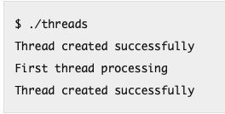
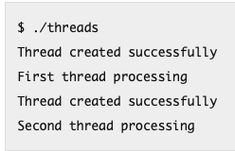
int pthread_equal(pthread_t tid1, pthread_t tid2); takes two thread IDs and returns a non-0 value if both IDs are equal, else it returns 0.
pthread_t pthread_self(void); // It is used by a thread for printing its own thread ID.
Without sleep() function:
With sleep() function:
Without the sleep* function, we did not see the message of “Second thread processing”:
Because just before the second thread is about to be scheduled, the parent thread, from which the two threads were created, completed its execution.
So that the default thread in which the main() function was running got completed and hence the process terminated as main() returned.
* sleep: sleep for the specified number of sec. Defined in <unistd.h>

Slide 304
Terminating a thread
(See the example code) In the code:
We created two threads using pthread_create()
The start function for both the threads is same: doSomeThing()
The threads exit from the start function using the pthread_exit() function with a return value (this is called inside the doSomeThing() function).
In the main function, after the threads are created, the pthread_join() is called to wait for each thread to complete.
Once both the threads are complete, their return value is accessed by the second argument in the pthread_join() call.

Slide 305
#include<stdio.h>
#include<string.h>
#include<pthread.h>
#include<stdlib.h>
#include<unistd.h>
pthread_t tid[2];
int ret1,ret2;
void* doSomeThing(void *arg) {
unsigned long i = 0;
pthread_t id = pthread_self();
for(i=0; i<(0xFFFFFFFF);i++);
if(pthread_equal(id,tid[0])) {
printf("\n 1st thread processing done\n");
ret1 = 100;
pthread_exit(&ret1);
}
else {
printf("\n 2nd thread processing done\n");
ret2 = 200;
pthread_exit(&ret2);
}
return NULL;
}
int main(void)
{
int i = 0, err;
int *ptr[2];
while(i < 2) {
err = pthread_create(&(tid[i]), NULL, &doSomeThing, NULL);
if (err != 0)
printf("\ncan't create thread :[%s]",
strerror(err));
else
printf("\n Thread created successfully\n");
i++;
}
pthread_join(tid[0], (void**)&(ptr[0]));
pthread_join(tid[1], (void**)&(ptr[1]));
printf("\n return value from first thread is
%d\n", *ptr[0]);
printf("\n return value from second thread is
%d\n", *ptr[1]);
return 0;
}
https://www.thegeekstuff.com/2012/04/terminate-c-thread/

